Slide 1
My family
Form 6 a Leonova Alex

Slide 2
My family
I want to tell you about my family. It is not very big. I have got a mother, a father , a brother and dog.

Slide 3
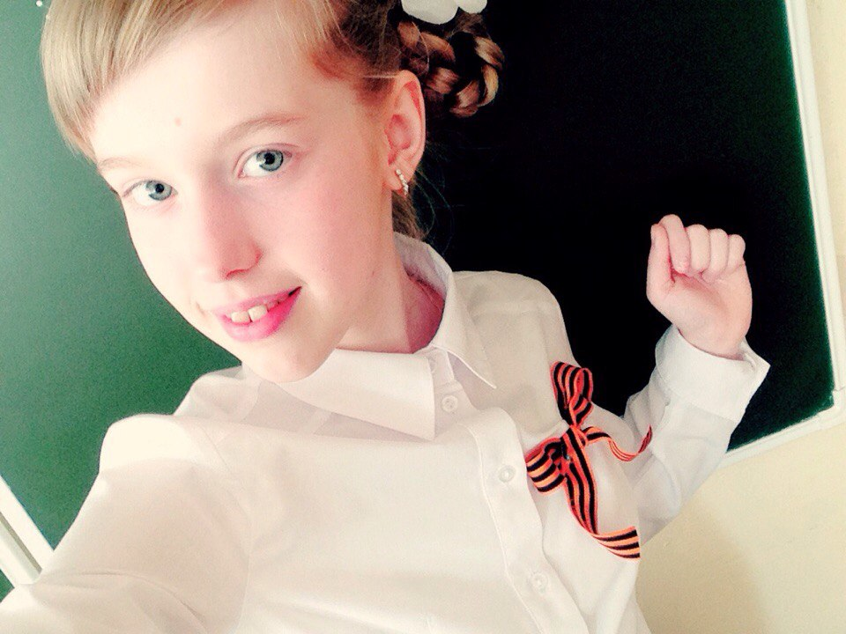
My family
Hello , my name is Sasha. My surname Leonova. I am twelve. I study in Farm 6. I like studing . I am very good at English and Russian.

Slide 4
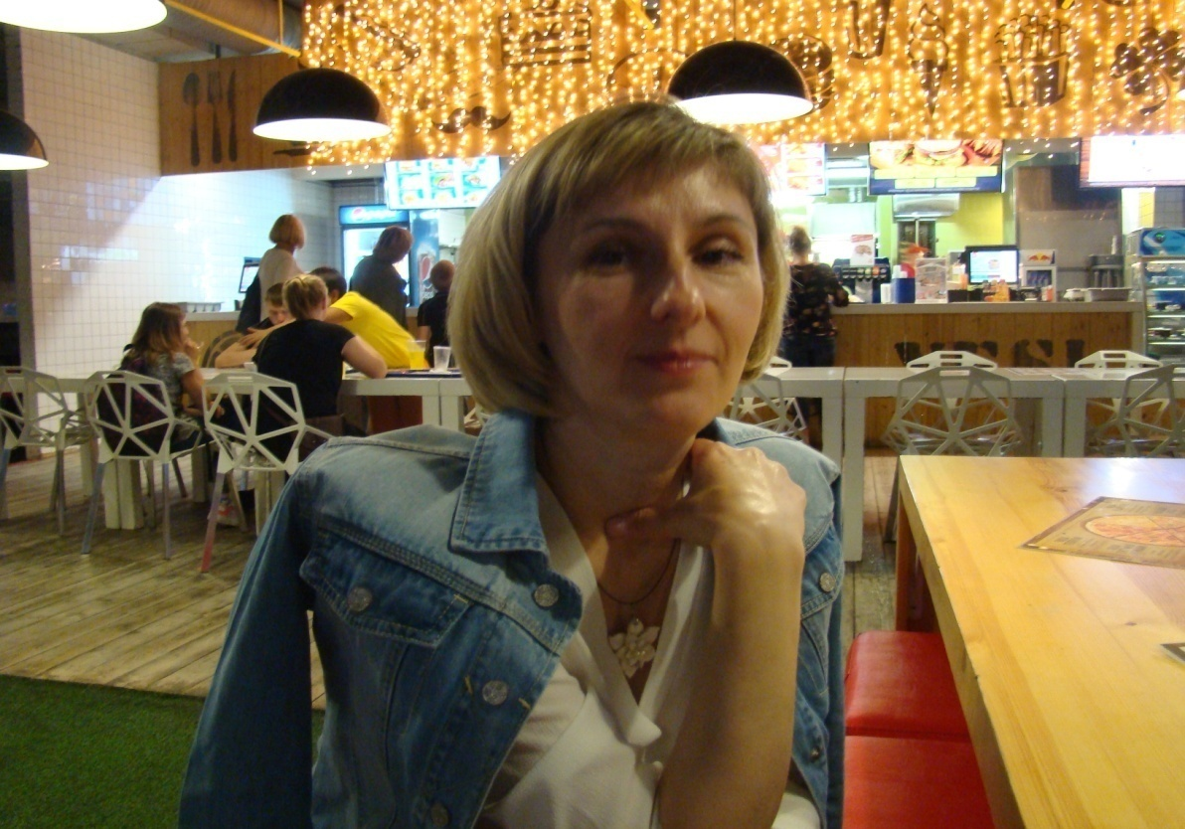
My family
My mother is Tatyana. She is a house wife. She is always ready to help me if I have problems. My mum is a nice and intelligent women.

Slide 5
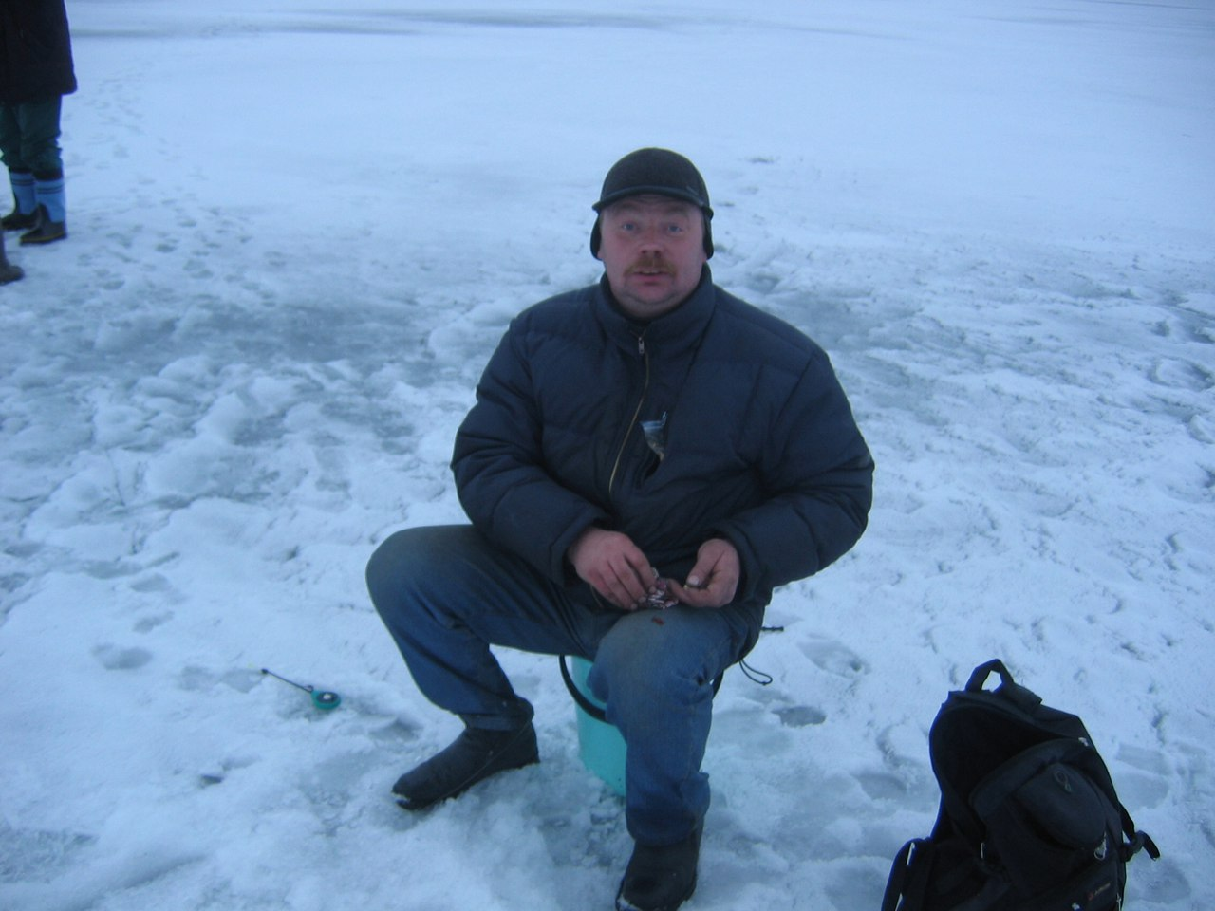
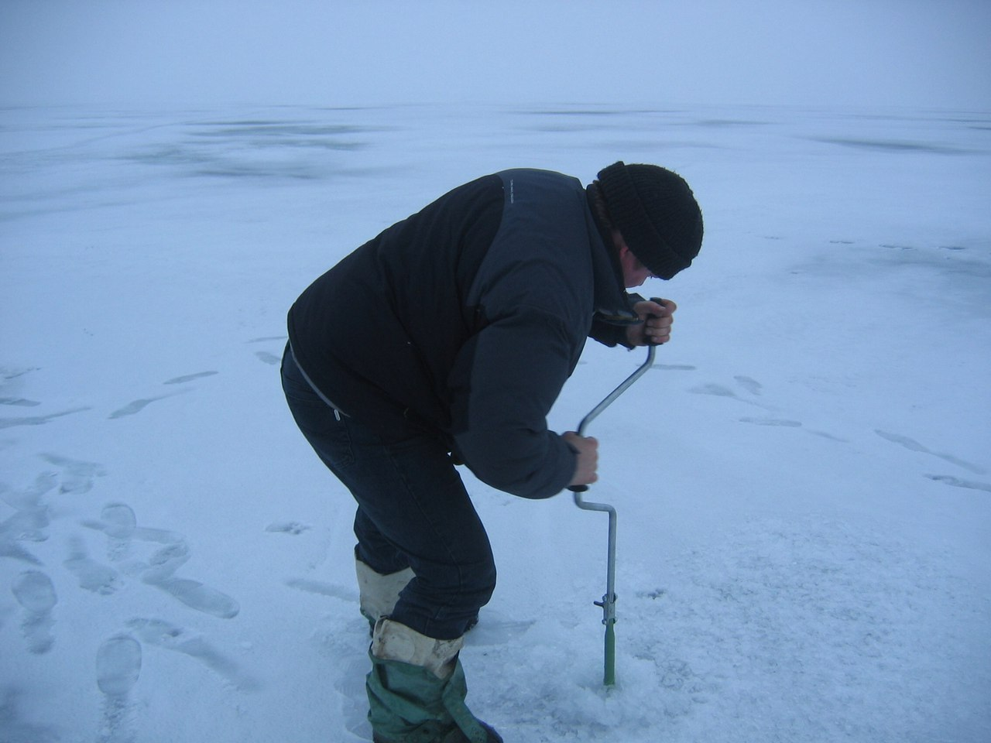
My family
My father is Oleg. He repairs cars. My father likes reading. Also he is a football fan and likes to watch football matches. And also my father is of fishing.

Slide 6
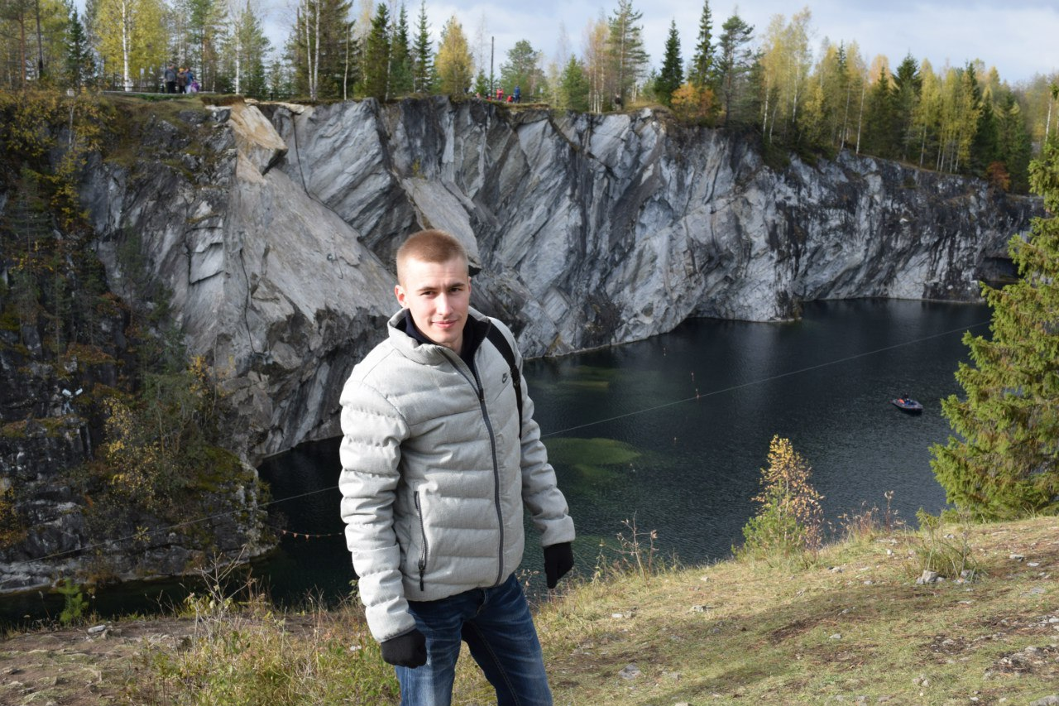
My family
My elder brother Dmitry is 25. He is a student and he works. I like talking with him. My brother is very nice . My brother very much likes to travel!

Slide 7
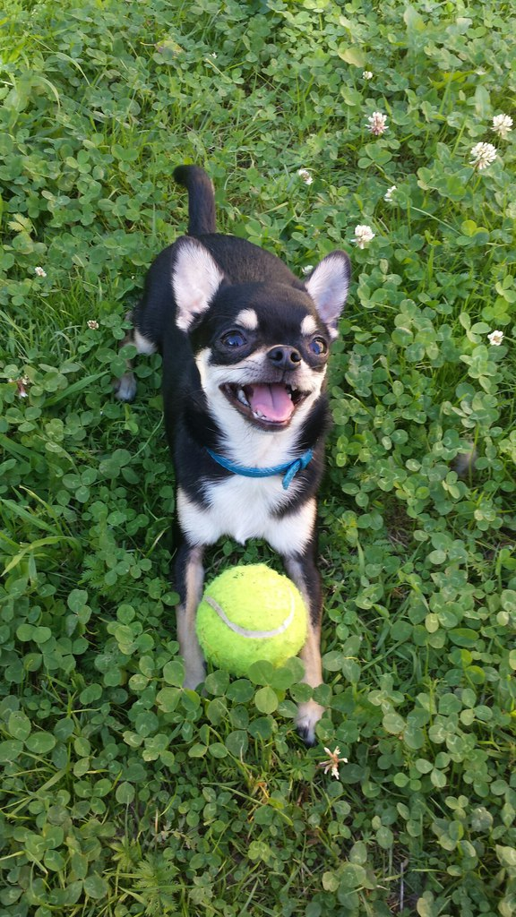
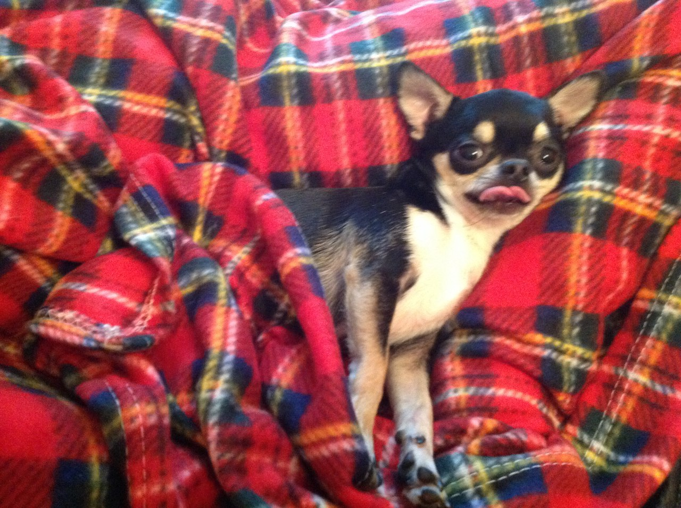
My family
My pet is dog Garik . He is funny . We with my family have thought up ridiculous nickname to a dog: Garik – Komarik.

Slide 8
When we together we are happy!

