Slide 1
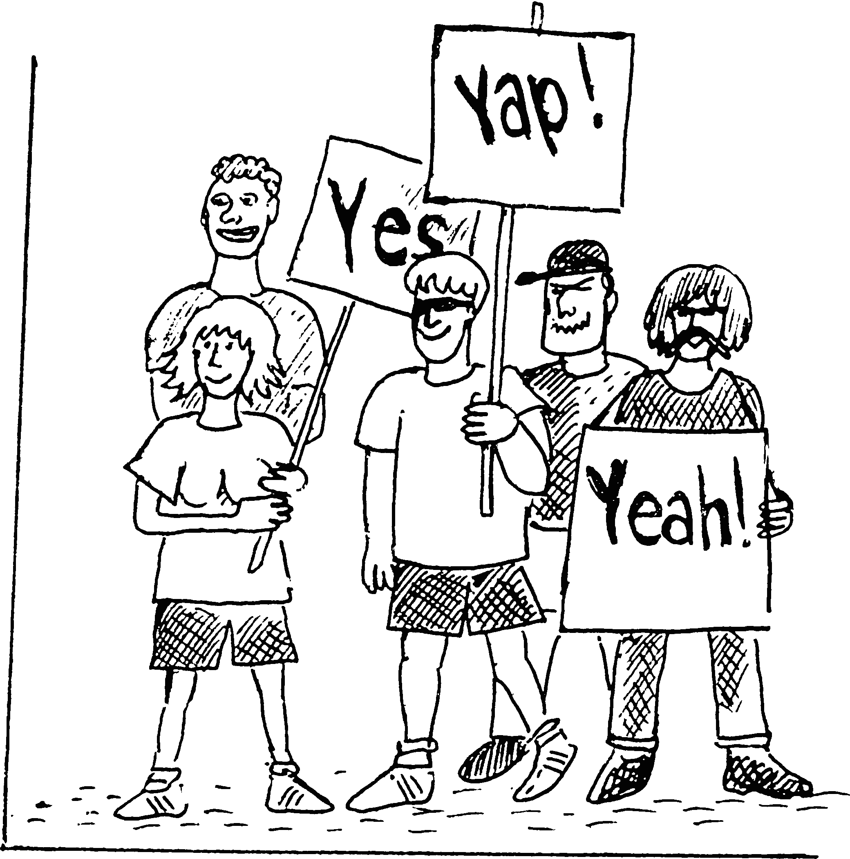
British and American
English

Slide 2
Differences.
Три самых главных различия между американским и британским английским – это:
Лексика, грамматика – различия в существительных и глаголах, особенно в использовании фразовых глаголов
Произношение – различия в гласных и согласных звуках, также как интонация и ударение
Написание – различия в определенных формах приставок и суффиксов

Slide 3
Grammar
British | American
Have you heard the news? | Did you hear the news?
He's just gone out. | He just went out.
I've got a sister. | I have a sister.
She hasn't got a car. | She doesn't have a car.
I've got a pen. | I've gotten a pen.
I suggest he should see the doctor | I suggest (that) he see a doctor.
He did not eat at all. | He did not eat any.
at the weekend | on the weekend
Monday to Friday | Monday through Friday
different from/to | different from/than
stay at home | stay home
write to somebody | write somebody

Slide 4
Grammar
British | American
I shall see a doctor tomorrow | I will see a doctor tomorrow
Многие британские английские неправильные глаголы в американском варианте стали правильными (например, burn - burned, dream - dreamed, lean - leaned, learn - learned, smell - smelled, spell - spelled, spill - spilled, spoil - spoiled).

Slide 5
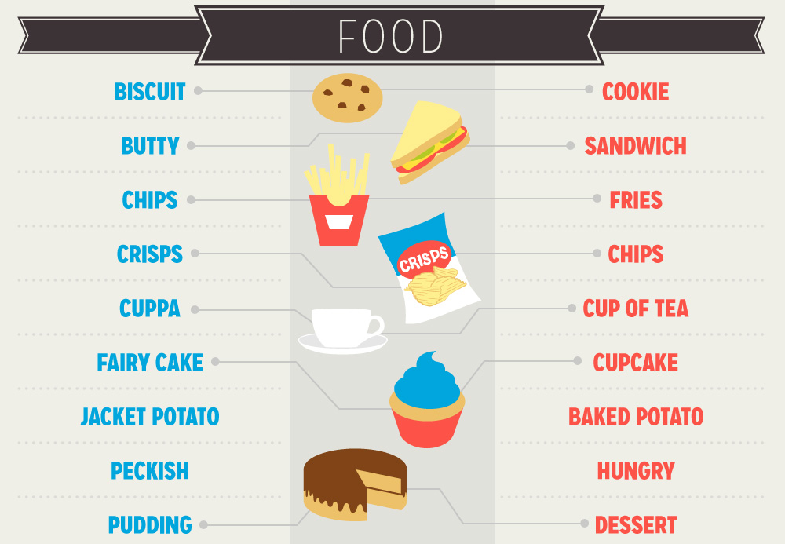
Vocabulary

Slide 6
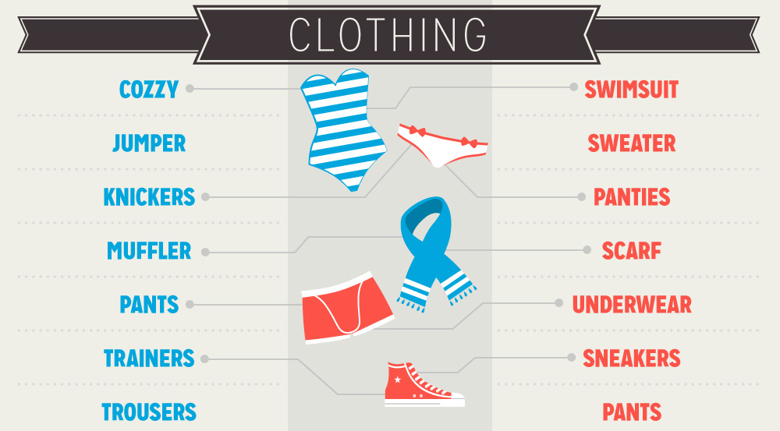
Vocabulary

Slide 7
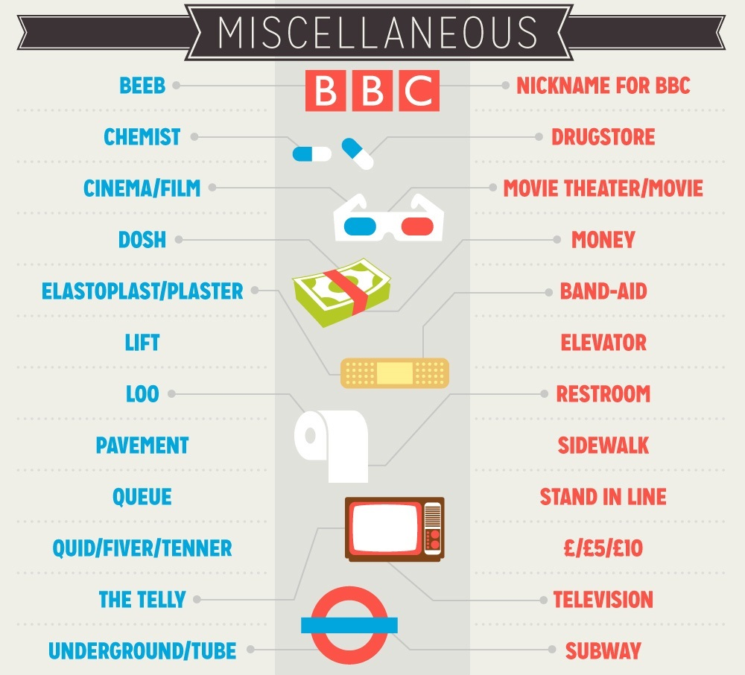
Vocabulary

Slide 8
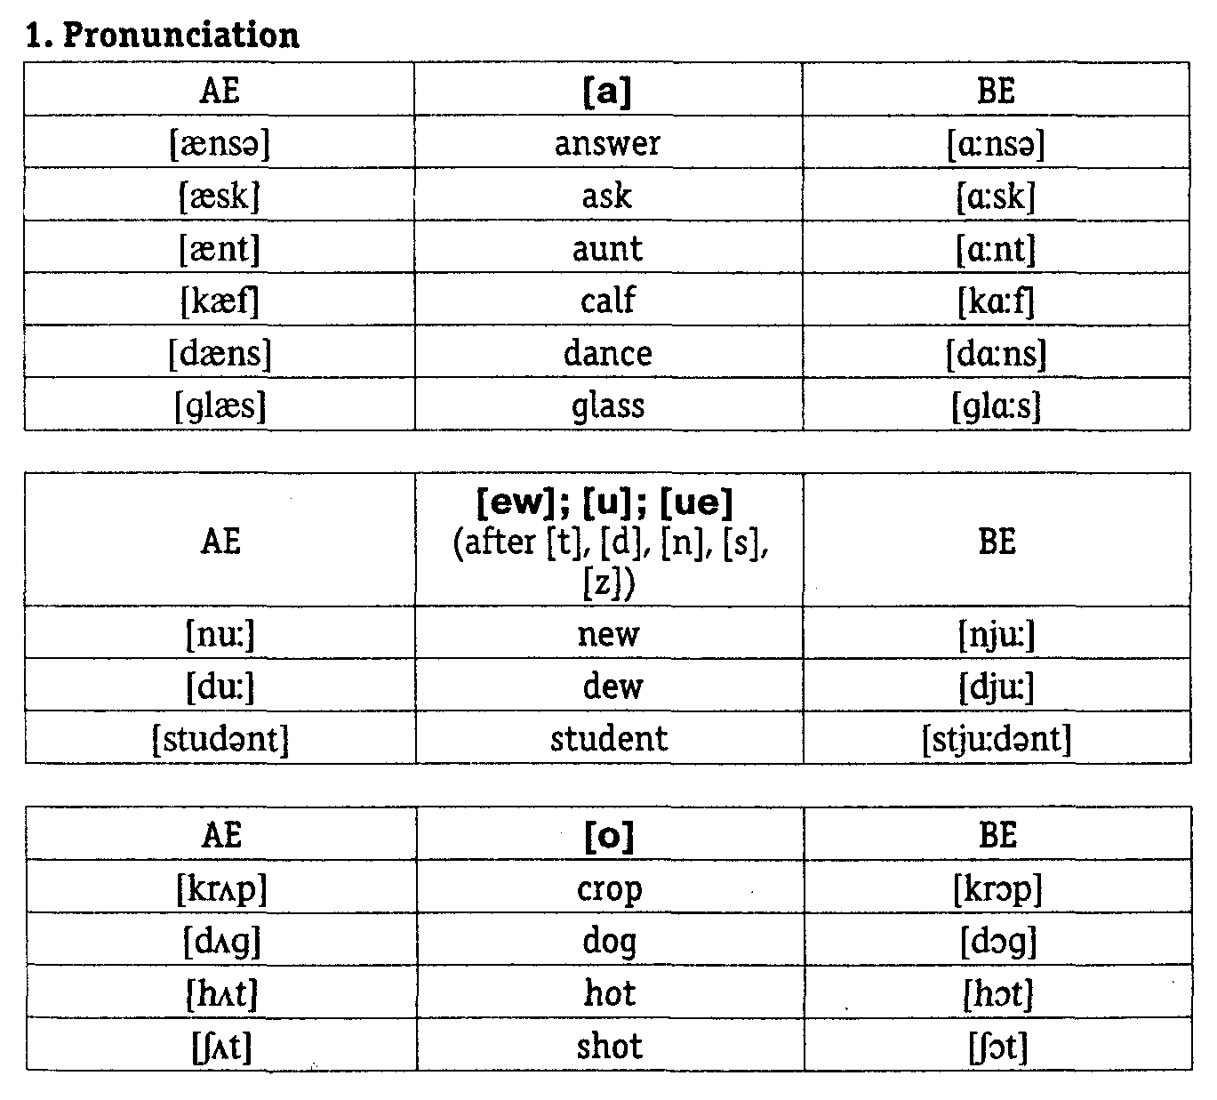
Pronunciation

Slide 9
Spelling
British | American | Translation
colour | color | Цвет
humour | humor | Юмор
flavour | flavor | Аромат
recognise | recognize | Узнавать
patronise | patronize | Покровительствовать
theatre | theater | Театр
progamme | program | Программа

