Slide 1
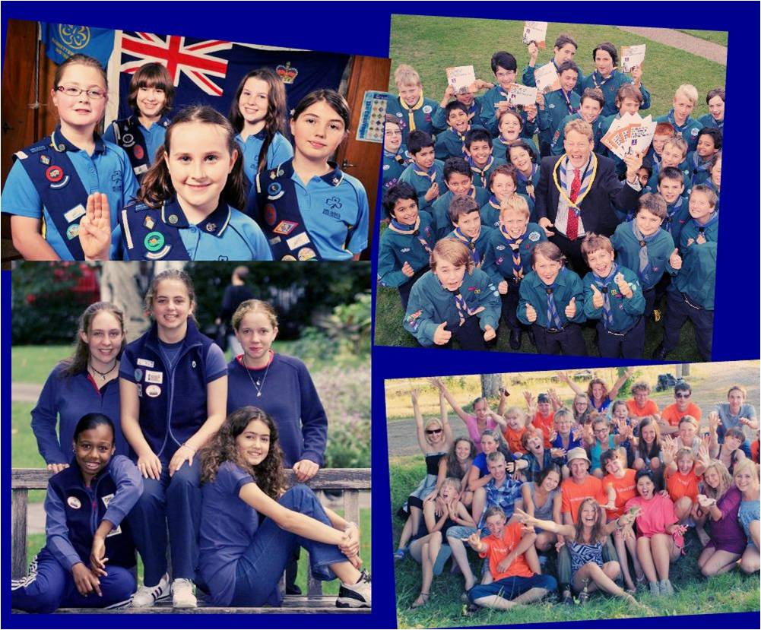
The Young People in Britain
Rozova M.
Smurova T.
Fedoseev I.
Teacher:
Glavatskih G.L.

Slide 2

The Youth Service
The British Youth Service reaches more than six million young people. The Youth Service promots the personal development and informal social education of young people.

Slide 3


Providing vital support
The Youth Service is mainly funded at local level and there is also some funding from central government departments. Many voluntary organizations cover their own costs through fund-raising activities and members' subscriptions. National youth organizations receive support from government departments for specific aspects of youth work.

Slide 4
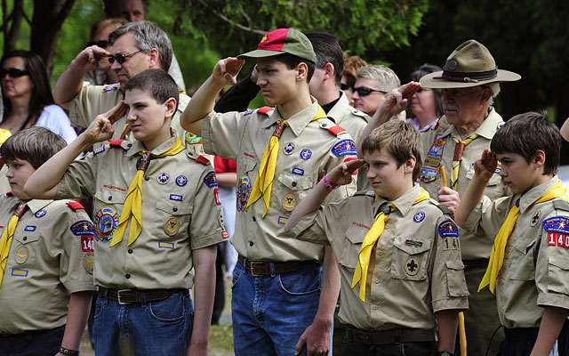
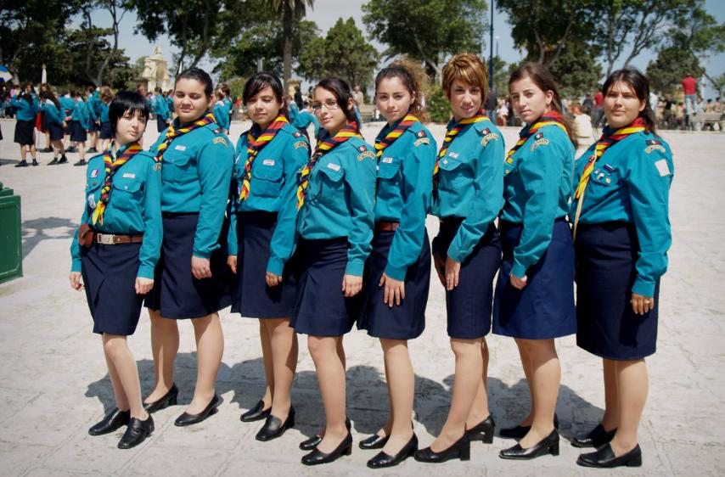
A brief history
The Service has a history over a period of 100 years. The first independent national organizations were the Boy Scouts and Girl Guides. They were established In the first decade of the 20th century.
The Youth Service has the opportunity and the duty to help all young people who have need of it, to others it may be a real rescue service.
The 1980s progressed the Youth Service increasingly particularly the problems faced by people from different social and ethnic backgrounds and the relative difficulties faced by young women in comparison with young men.
The work of youth service organizations now is aimed at rural isolation, racial discrimination and homelessness.

Slide 5

Sixteen and After
Sixteen is a crucial age. This is when young men and women have to decide whether to stay at school, to go on to a college, to look for a job, or to start a Youth Training program. All have to think about gaining employment in a job market which demands increasingly skilled workers. Many study for 'A and AS level qualifications. These are - two year courses in single subjects. Students will usually take two or three subjects which may be combined with one or two 'AS' courses.

Slide 6

Gearing for work
The Government is keen that more young people should stay on at school or college for the period between 16 and 18, not just to do academic work but also to gain practical skills which will prepare them for employment. Colleges of further education offer a number of more vocationally orientated courses for 16 to 18 year-olds. Different organizations prepare young people for work in various occupations such as business, engineering, administration, catering and tourism.

Slide 7

Higher education
After their period in further education young people have the opportunity to go on to higher education in a university, polytechnic or college, provided they have good 'A' level exam results or good passes in vocational qualifications like the BTEC national diploma. Higher education courses usually last three years . Most higher education students receive some financial support from LEAs, with the rest of their money made up through parental support or through the Student Loans Company set up by central government to provide subsidised loans for students.

Slide 8


Negotiating the job market
Unless they are fortunate enough to have a job to go to, the first stop for young people entering the job market at 16 is their local Jobcentre or careers office. Some school careers advisers teach such skills as filling out a curriculum, vitae or writing letters applying for jobs but for many young people this is uncharted territory. Youth workers in the Youth Service organisations also give advice and counseling.

Slide 9
THANKS FOR YOUR ATTENTION!

