Slide 1
Traditions and holidays of Great Britain

Slide 2
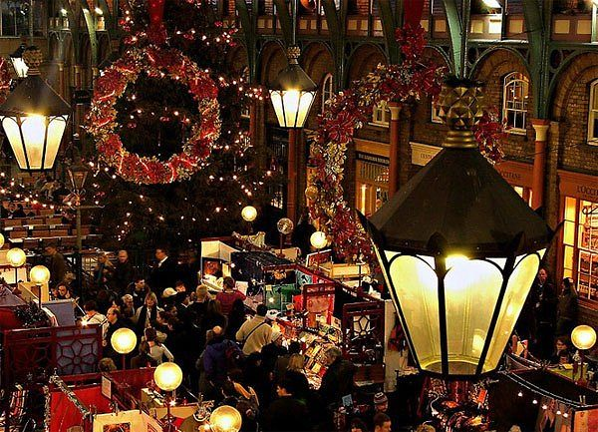
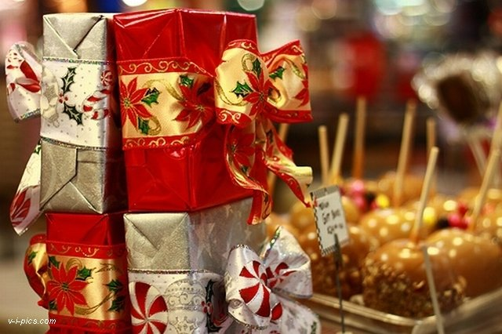
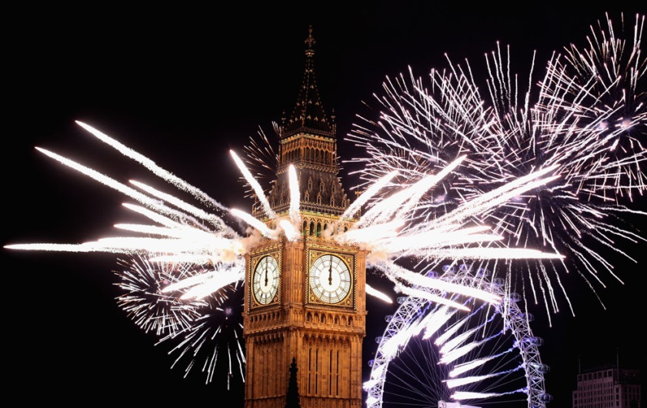
Holiday
Christmas The most common type of celebration is a New Year party

Slide 3
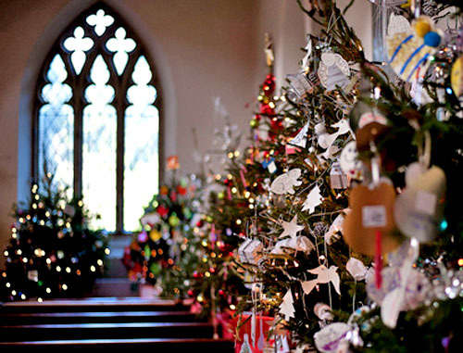
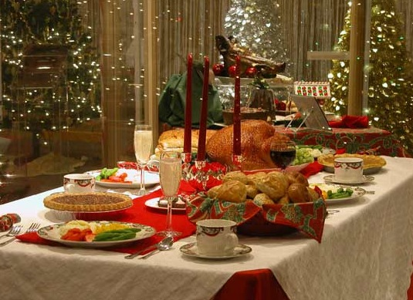
Christmas
People in Britain celebrate Christmas on 25 December. Families decorate their homes and Christmas trees. People prepare presents, make Christmas cakes. On Christmas Day everyone opens presents and sits down to the table to have turkey or goose with vegetables. After dinner the family gathers in the living room to listen to the Queen on TV.

Slide 4
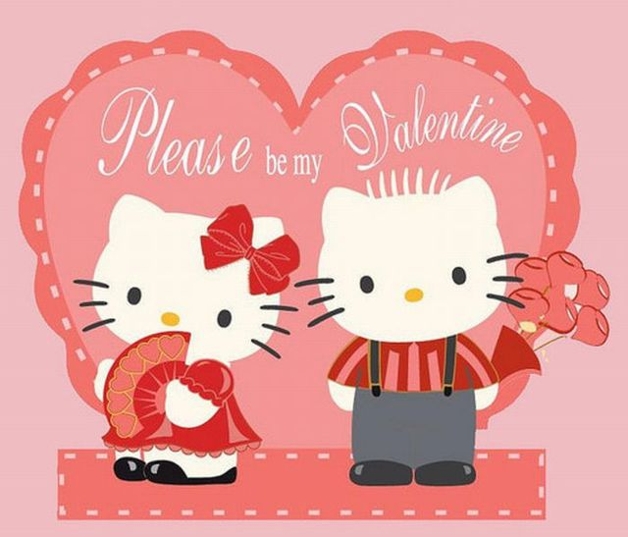
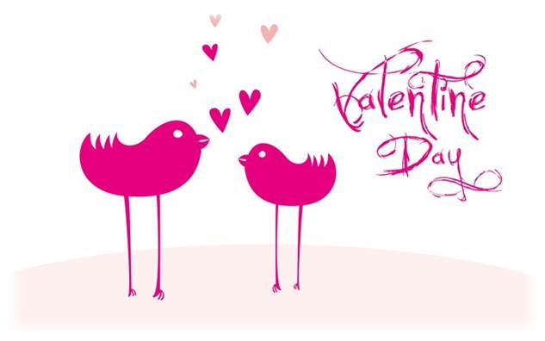
Valentine's day
On St Valentine`s Day people send a special valentine to those who they love. Some people buy presents for their sweethearts or give them a red rose, a symbol of love.

Slide 5
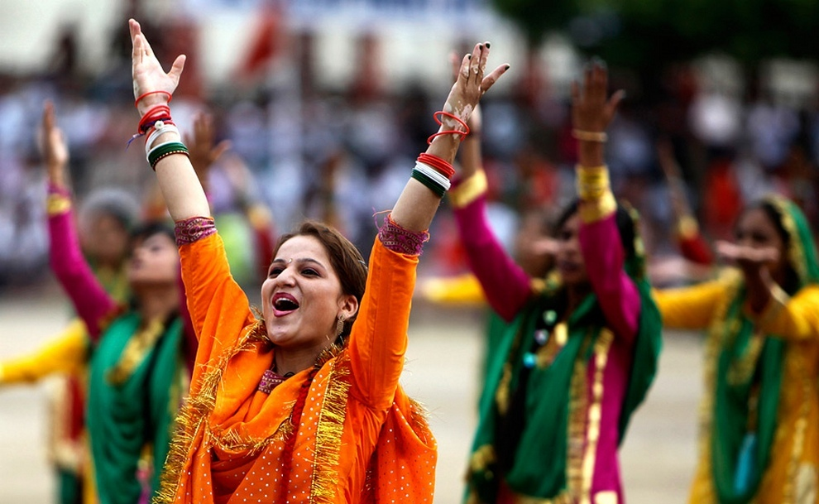
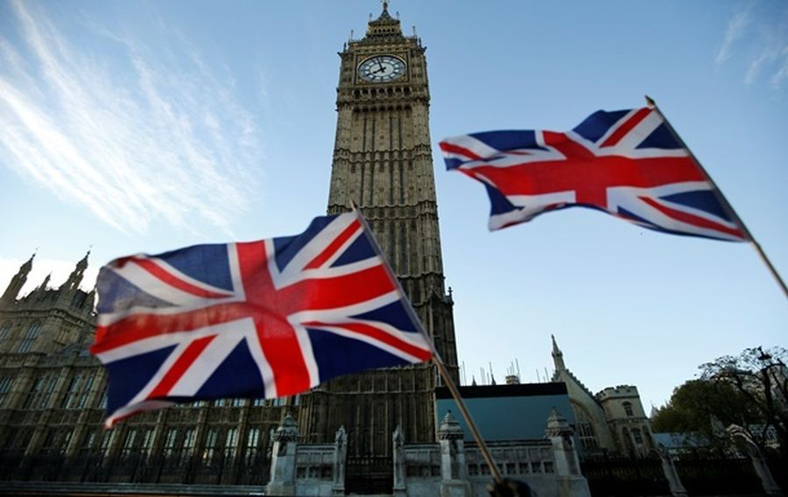
Independence Day
On July 4 the Americans celebrate their national holiday — Independence Day. Some cities have parades with people dressed as the original founding fathers who march to the music of high school bands. In the evening people gather to watch firework displays. Wherever Americans are around the globe they will get together to celebrate Independence Day.

Slide 6
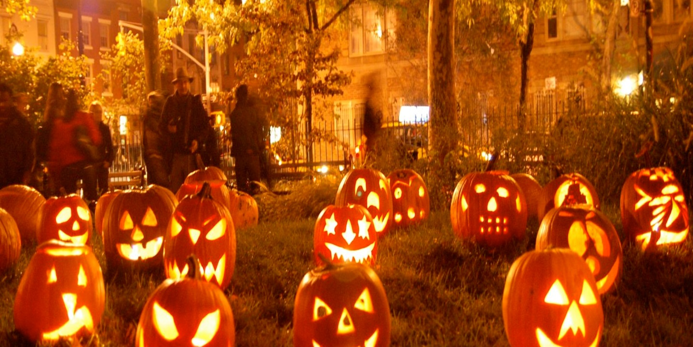
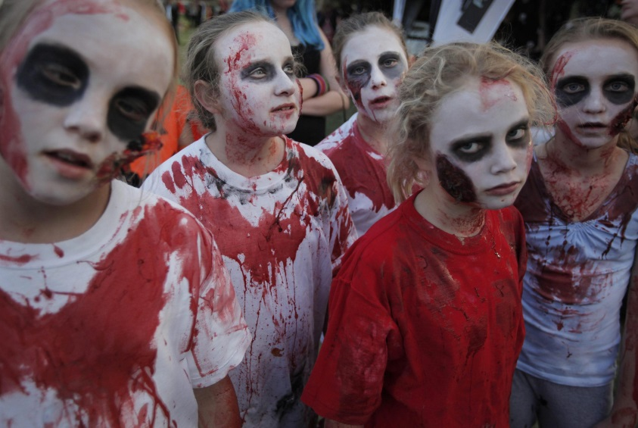
Halloween
Halloween is a festival that takes place on October 31. children wear costumes and masks and go trick-or-treating. Many of them carve jack-o'-lantens out of pumpkins. Fortunetelling and storytelling about ghosts and witches are popular activities.

Slide 7
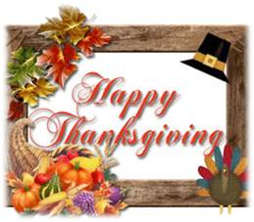
Thanksgiving Day
This holiday is one of the big six major holidays of the year. People of all faiths celebrate this day. They give thanks for the many good things in their lives. Thanksgiving Day is a traditional family holiday. So on that day families always come together, especially for the wonderful meal. A large roasted turkey with stuffing is the most common main dish of a Thanksgiving dinner, that’s why Thanksgiving is sometimes called “Turkey Day”

Slide 8
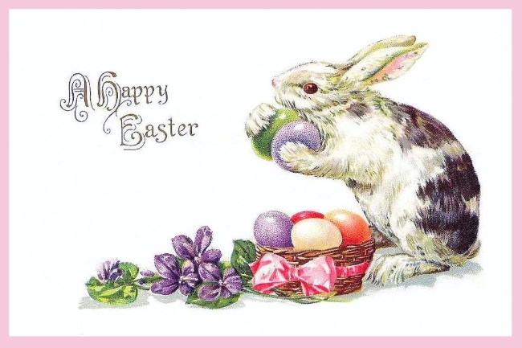
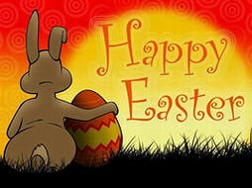
Easter
Easter is the time for holidays, festivals and time for giving chocolate Easter eggs, the day of parties, and above all a celebration that Jesus raised from the dead and lives forever. Eggs play an important part in Easter celebration; they are predominantly given to children. The eggs are either hollow or have a filling, and are usually covered with brightly colored silver paper.

