Slide 1
Our school - 40. Happy Birthday, dear school!
Made by Lukkanen Igor Form 9a
Teacher Glavatskih Galina Leonidovna
2016
Kommunar school №1

Slide 2
Content:
1.The early days.
2. Interior.
3. A new sports ground.
4. Our proud.

Slide 3
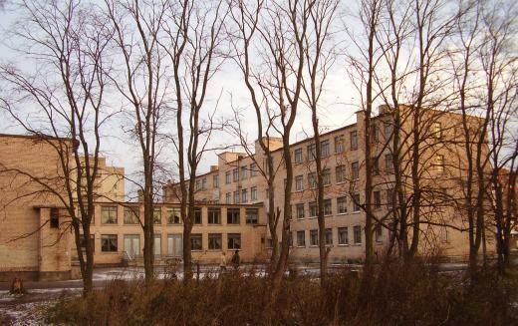
The school number 1 was built in 1975 in Kommunar. It was the first school in this town. The age of our school is 40 years, it was built last century, but it is still the best school.

Slide 4
Our school is a four-stored building of a typical design.
The ground floor is for primary school pupils.
The classrooms for different subjects are on the first, second and third floors. Of course, we have a big computer lab. There are a lot of modern computers in the lab. Our Chemistry, Physics and Biology labs are modern too. I like working in our labs a lot.
Most of our classrooms have computers, TV-sets, video players, so teachers show us educational programmes.

Slide 5
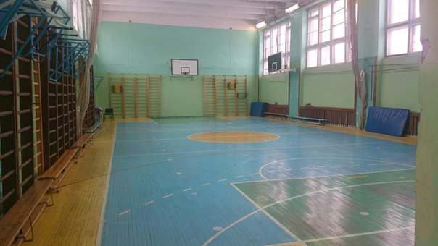
We have got a gym-hall with two changing-rooms: for boys and for girls. There are a lot of sport equipments in the gym-hall. In the gym-hall we have P.T. lessons. Our gym is up-to-date.

Slide 6
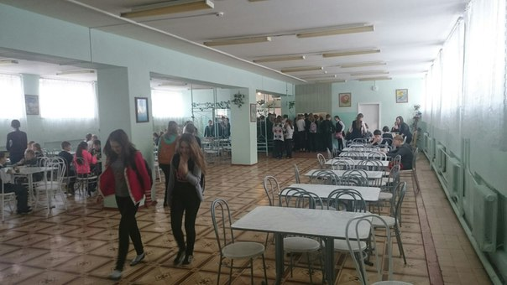
If you want to eat, you will go to our canteen. We usually have breakfast and lunch in the canteen. They are always tasty and nice.

Slide 7
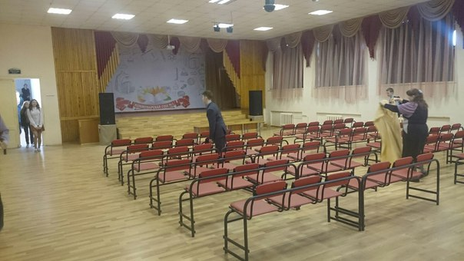
There is also an assembly hall in our school.Various events are held there. School meetings and concerts take place there. There is a large stage and modern equipment for school plays and concerts. We like to spend free time in our school hall.

Slide 8
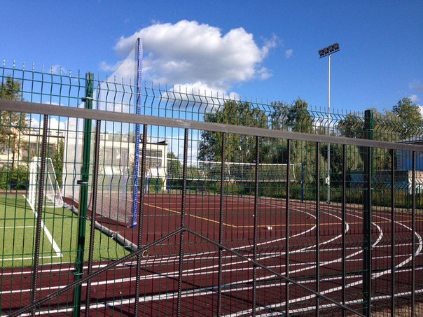
A new sports-ground was built nearly our school last year. There is a football field, a volleyball court, a jogging track and horizontal bars. Here on the sport ground we have our classes in physical training when the weather is fine.

Slide 9
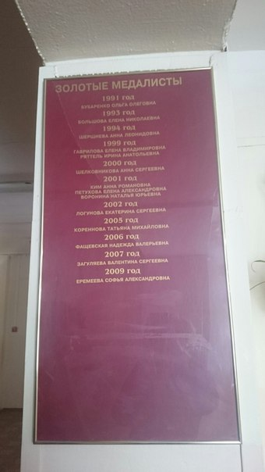
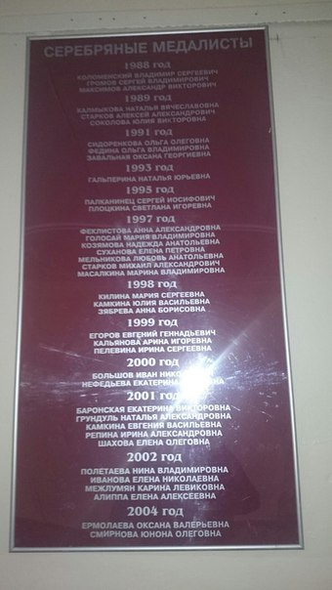
Our school has got a lot of good teachers nowadays. And many teachers had been working there for these 40 years. Many gold and silver medalists have finished our school. Here are the names of them:

Slide 10
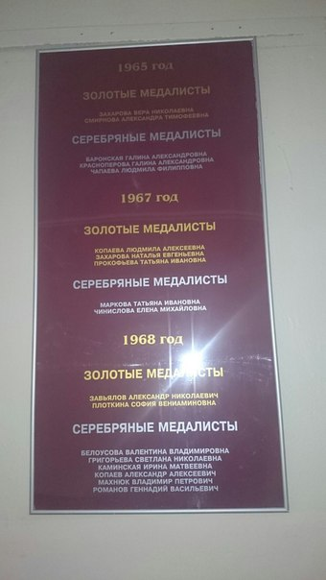

Slide 11
I believe a lot of gold medalist will finish it in the future. I really like my school and I am happy to study in it!
Интервью

Slide 12
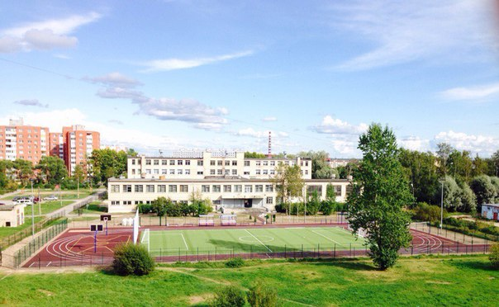
Welcome to our school!
I hope you liked our school too.

