Slide 1
things we do every day are daily routine

Slide 2
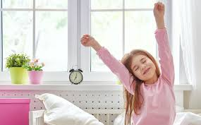
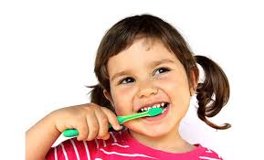
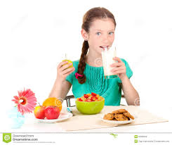
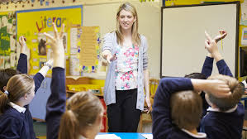
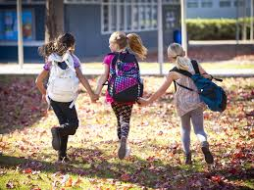
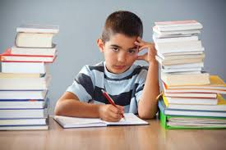
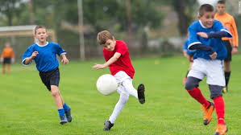
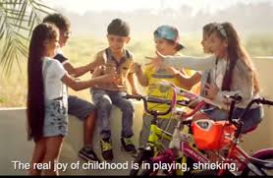
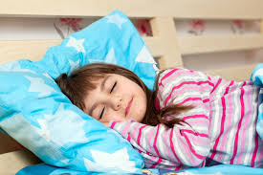
Wake up
Have breakfast
Brush teeth
Have lessons
at school
Go to school
Do homework
Play sports
Go to bed
Go out with friends

Slide 3
Present Simple
Positive
I/you/we/they play | he/she/ it plays
Negative
I/you/we/they don’t play He/she/ it doesn’t play
Questions
Do I/you/ we/ they play? | Does he/she/it play?
Wh- questions
What | do | I/we/you/they | Play?
Where | does | He/she/it

Slide 4
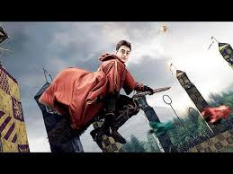
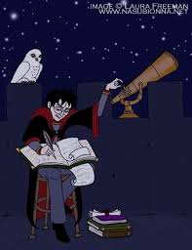
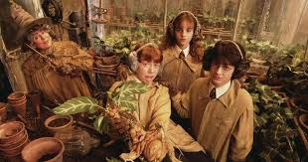

Harry Potter’ s Routine

Slide 5
Adverbs of frequency
! Come before the main verb
I always wake up early
We don’t usually go out on Fridays
What do you usually after school?
! Come after the verb be
I am never late to school
always
usually
often
sometimes
never

Slide 6
Home task
SB - p 37 ex 9 Write a paragraph about your typical day. What a typical day for you? Make notes , then writes a short paragraph

Slide 7
In the morning
In the afternoon
In the evening
Brush teeth
Have breakfast
Go to school
Have lessons
Have lessons
Play sports
Do homework
Have dinner
At night
At weekends
Go to bed
Play sports
Go out with friends

Slide 8
