Slide 1
TYPES OF HOUSES

Slide 2
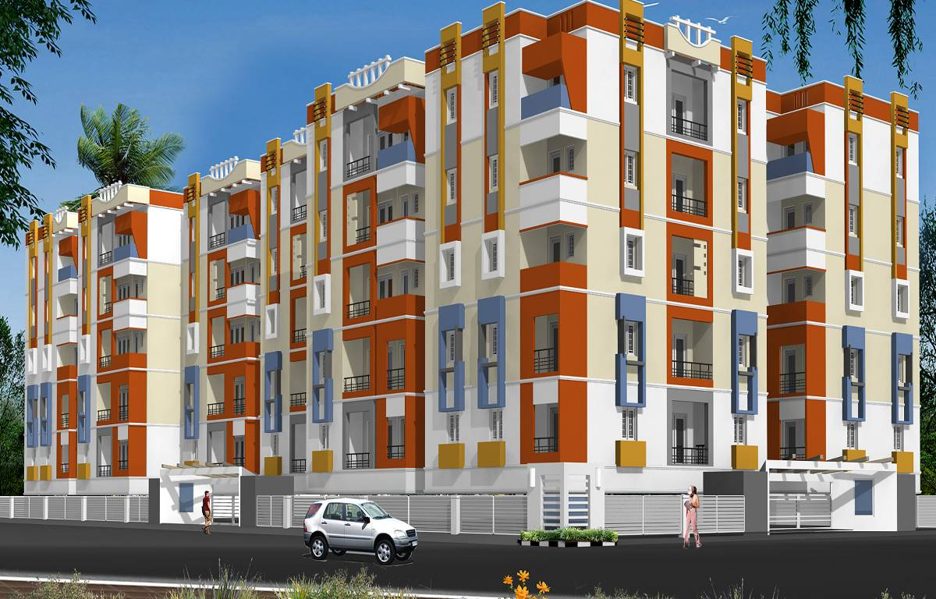
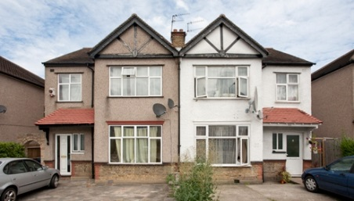
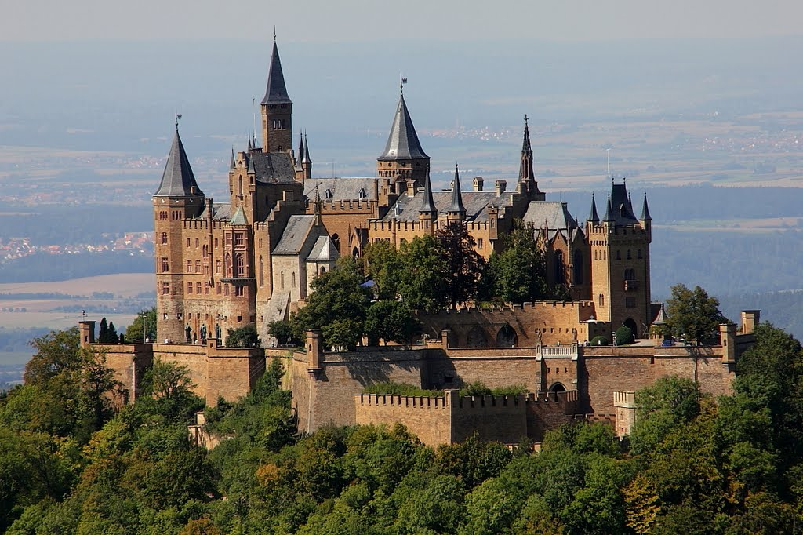
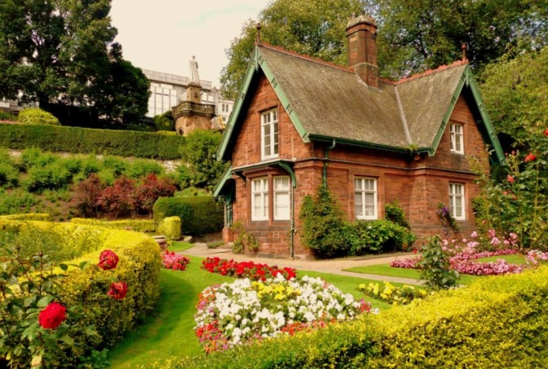
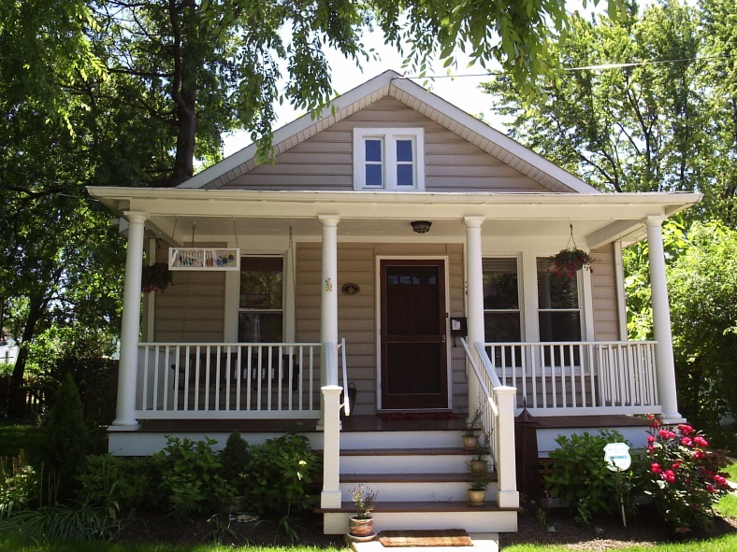
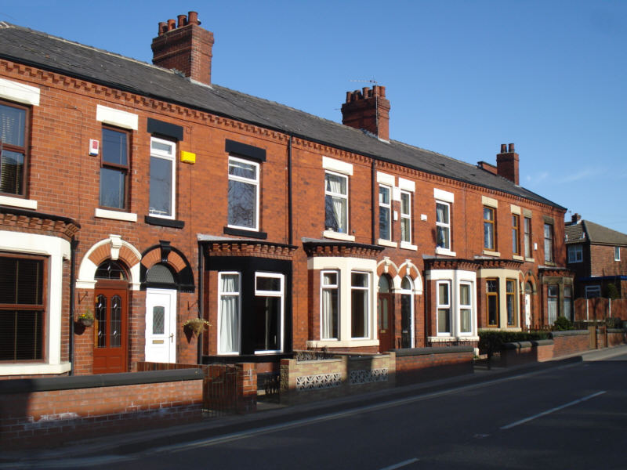
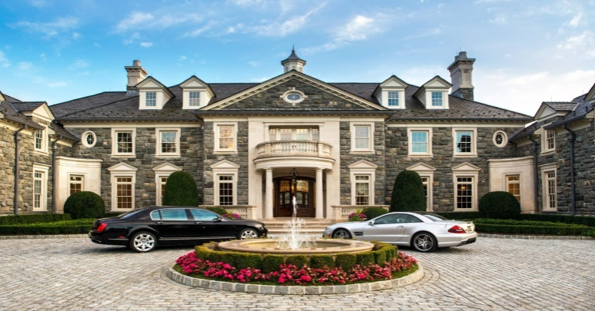

Slide 3
Detached house
Semi-detached house
Bungalow Cottage Mansion
Terraced house Flat
Appartment Block(Building)
,

Slide 4
Detached house

Slide 5
cottage

Slide 6
mansion

Slide 7
bungalow

Slide 8
SEMI-DETACHED

Slide 9
terraced house

Slide 10
Apartment/ flat

Slide 11
Apartment Block/Building

Slide 13
Let’s have a break

Slide 14
HOME TASK
SB: p. 25, ex. 7 (Learn by heart new words and phrases)
WB: ), p. 30 ex. 21,22 ( Read Natalie’s letter and write her a letter with the description of your house)

