Slide 1
«Amazing magnetic properties of chewing gum for hands (HandGum)»
МБОУ Коммунарская СОШ №1
Project by: Vinogradova Lidiya and
Goncharova Ekaterina

Slide 2
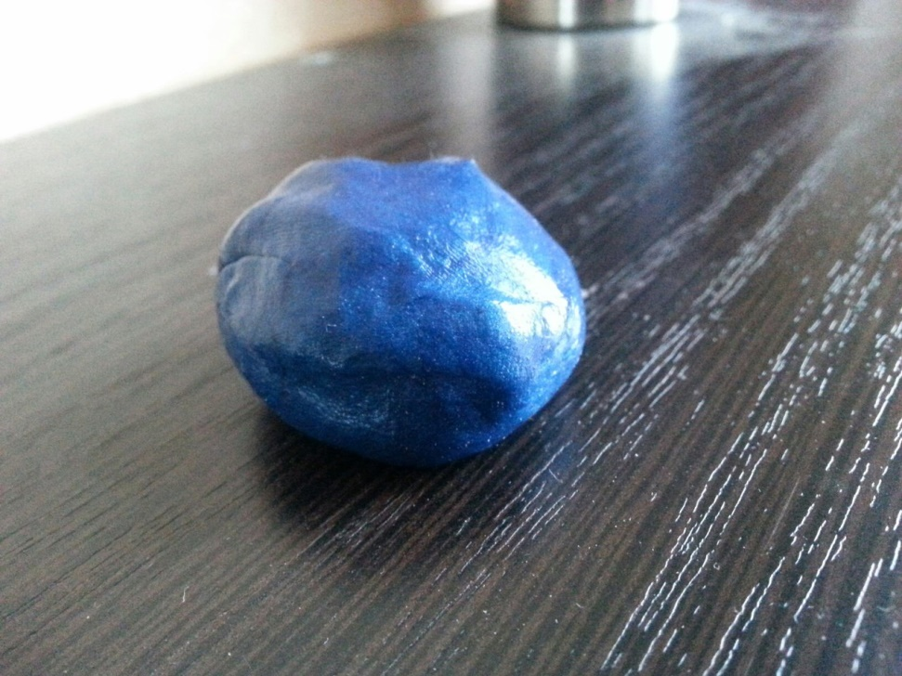
RESEARCH SAMPLES
HandGum or chewing gum for hands

Slide 3
Research goal
Research magnetic qualities of HandGum.

Slide 4
Project tasks
Research the literature related to HandGum.
Study the qualities of HandGum in more detail.
Study the composition of this substance.
Find out application spheres.
Describe magnetic qualities.

Slide 5
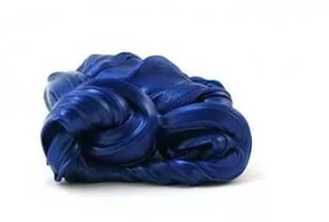
What is Handgum?
HandGum is material that is similar to such things as "smart clay", "lizun" and balls with flour.

Slide 6
HandGum Composition
% | Substance | Description
65 | Dimethyl siloxane | chemical compound
17 | Silica | Crystalline quartz
9 | Thixatrol ST | Castor oil derivatives
4 | Polydimethylsiloxane | linear polymer dimethyl siloxane
1 | Decamethyl cyclopetnasioloxane | organosilicon compound
1 | Glycerol | simplest representative of trihydric alcohols
1 | Titanium dioxide | Colorant

Slide 7
HandGum qualities
Substance is non-toxic.
It has no smell and taste.
It is not sticky, does not make your hands greasy, because HandGum is a silicone-based substance.
It burns.
Depending on various additives, HandGum can be in different colors, it can glow in the dark and change its color.

Slide 8
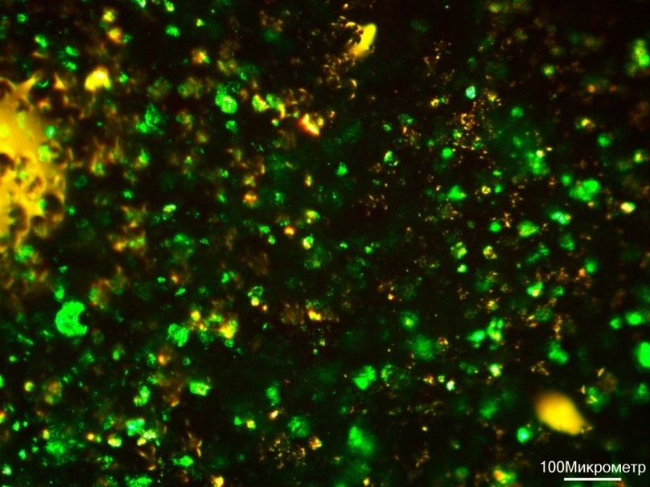
Microscopic examination of the surface HandGam
Figure 1
Figure 2

Slide 9
Research procedure
We tested HandGum for its magnetic properties. We placed the chewing gum in the region of a strong magnetic field, trying to magnetize it.
The study showed that HandGum becomes magnetized under the influence of this magnetic field, but if we take it out of given field, it ceases to have magnetic properties. Thus, we can conclude that our object is a paramagnetic, with a sufficiently large magnetic permeability characteristic of ferromagnets.

Slide 10
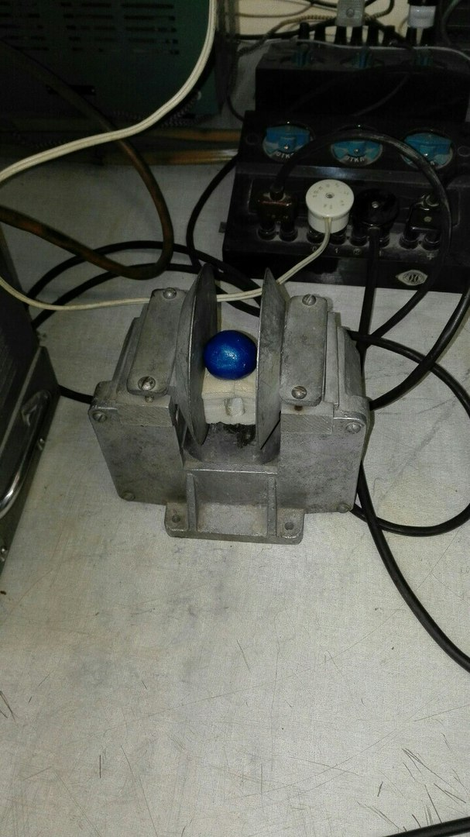
HandGum in a strong magnetic field

Slide 11
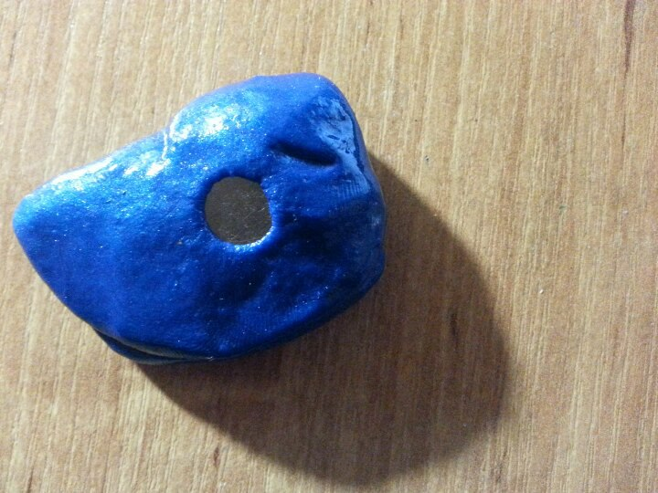
Unusual HandGum quality
If you put a magnet near magnetic HandGum, you can see that it slowly absorbs the magnet.
It contains particles that can attract a magnet. These particles can be charged by a magnet and attract small metal objects as well.

Slide 12
References
1. http://cosmos-tut.livejournal.com/64219.html
2. http://po-nomeram.com.ua/a226096-hendgam-chudo-zhvachka.html
3.http://genius.pstu.ru/file.php/1/pupils_works_2014/Akhtjamov_Maksim.pdf
4. http://dic.academic.ru/dic.nsf/ruwiki/442009

Slide 13
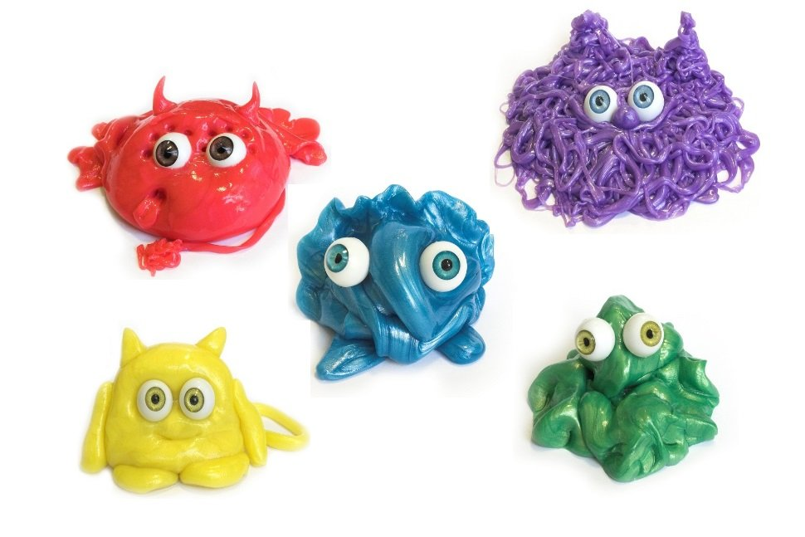
Thank you for attention!

