Slide 1
Health Matters
Выполнил :Gribanov Tolya

Slide 2
What is a healthy lifestyle?
A healthy lifestyle is a person's lifestyle, aimed at preserving health, preventing diseases and strengthening the body as a whole. A healthy lifestyle is very important, since the person himself becomes more beautiful, pleasant and influential for other people. Healthy person as an example for the rest.

Slide 3
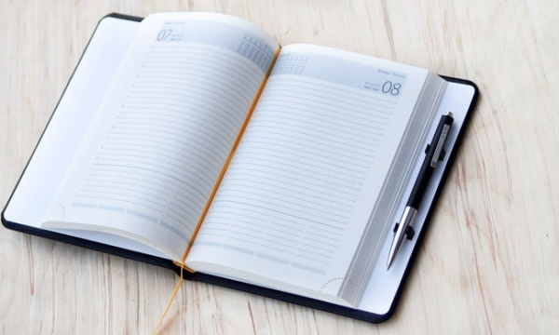
What you need to do to start a healthy lifestyle? the first:
The most important thing is to start your daily routine in the morning and get up early. This is the most important thing in a healthy lifestyle.

Slide 4
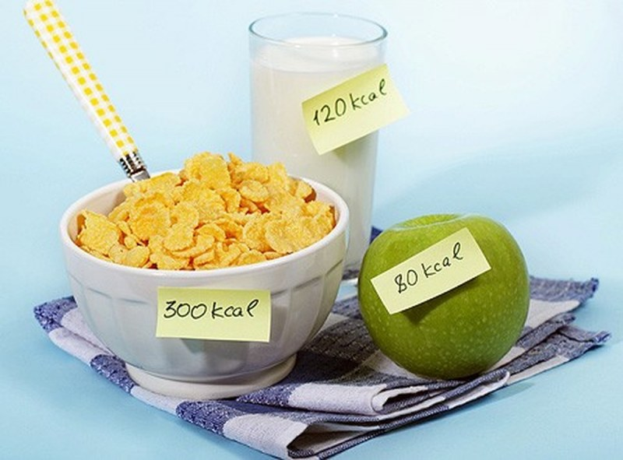
the second:
Not an important thing is to get rid of bad habits, harmful and junk food. Start eating right to avoid excess weight.

Slide 5
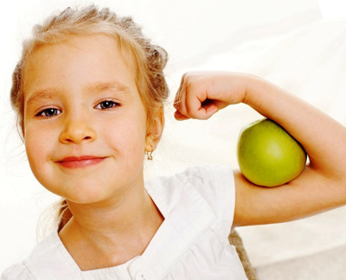
The third:
Start training at least twice a week or choose sport if you don’t have it, so that your body is always charged with energy and you don’t feel like a falling apart person. You can simply train at home at least thirty minutes a day, because this is not so much, but also useful. Maintaining physical fitness is very important.

Slide 6
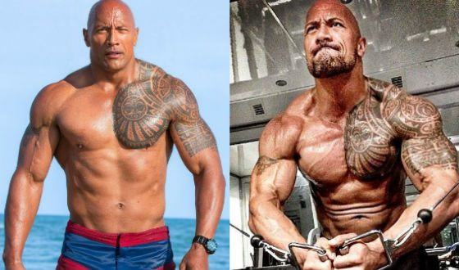
What does a healthy person look like?
A healthy person who observes all the rules of a healthy lifestyle looks nice and beautiful both externally and internally. A healthy person as an example for society, he is pleasant in communication, smart and can always stand up for himself. A healthy person is more likely to become successful in his career.

