Slide 1
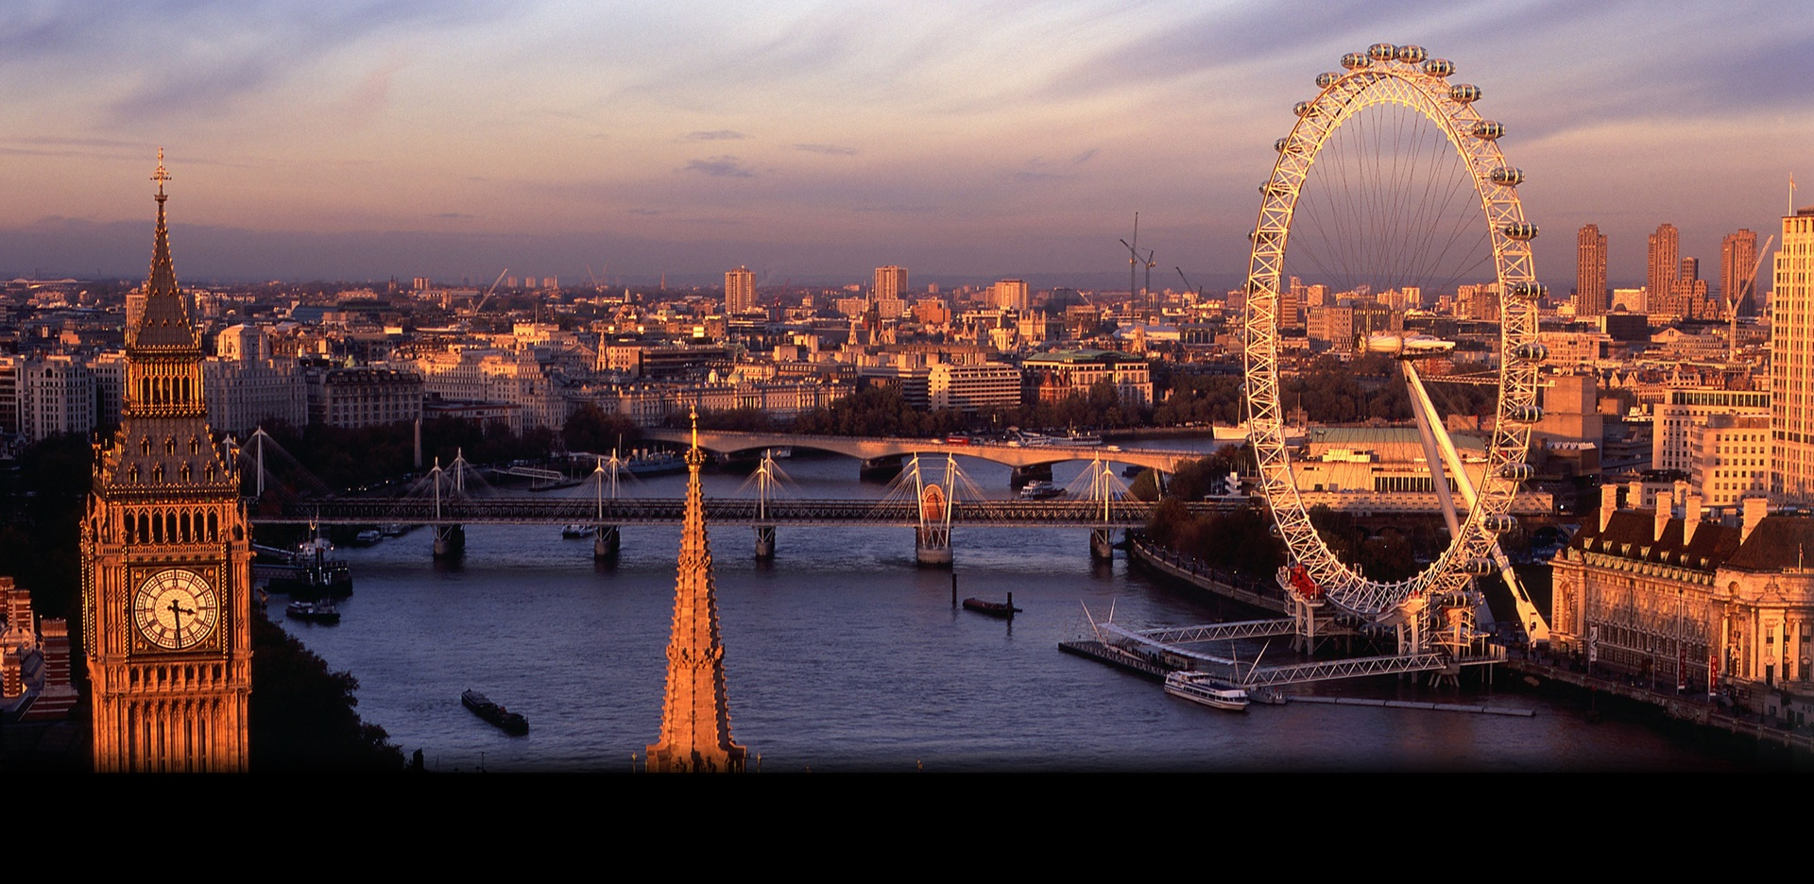
Sights of London

Slide 2
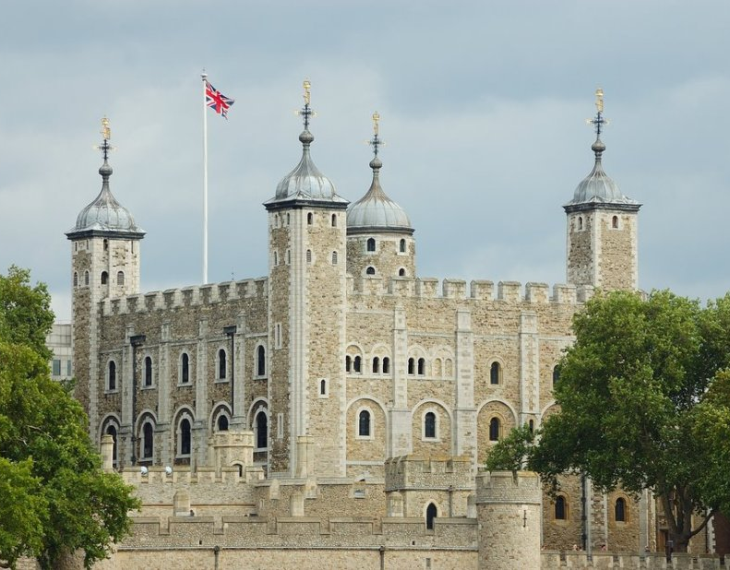
The Tower of London The Tower of London is one of the most imposing and popular of London's historical sites. It comprises not one, but 20 towers. The oldest of which, the White Tower, dates back to the llth century and the time of William the Conqueror. Nowadays a lot of tourists visit the Tower of London, because of the Tower's evil reputation as a prison. The Tower is famous as home of the Crown Jewels. Today they can be viewed in their new jewel house. They include the Crown of Queen Elizabeth the Queen Mother which contains the celebrated Indian diamond. Many stories associated with British history come from the Tower. In 1483 King Edward IV's two sons were murdered in the so-called Bloody Tower. Over two centuries later the skeletons of two little boys were found buried beneath steps in the White Tower. Of course, no visit to the Tower would be complete without seeing the ravens; huge black birds who are an official part of the Tower community. Legend states that if the ravens were to leave the Tower the Crown will fall, and Britain with it. Under the special care of the Raven Master, the ravens are fed a daily diet of raw meat. And there is no danger of them flying away, because their wings are clipped.

Slide 3
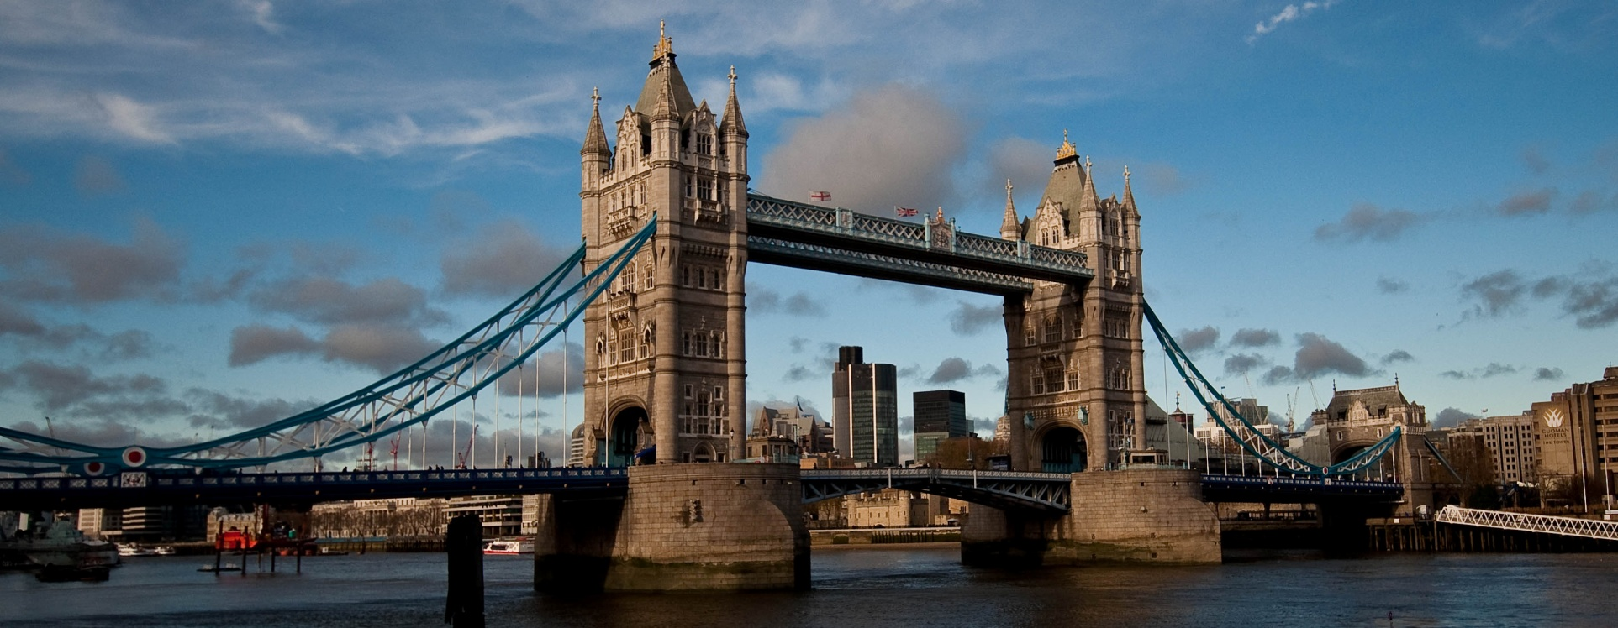
Tower Bridge. This bridge built in 1894, is still in daily use even though the traffic in and out of the London wharves' has increased to an extraordinary extent during the course of the 20th century. Even today Tower Bridge regulates a large part of the impressive traffic of the Port of London. Due to a special mechanism, the main traffic-way consisting of two parts fixed to two hinges at the ends can be lifted up. In this way, the entrance and departure of extremely large vessels is possible, and allows them to reach the Pool of London. Nowadays the pedestrian path is closed. This footpath crossing which used to be allowed was by the upper bridge which connected the top of each tower, situated at a height of 142 feet above the waters of the famous Thames.

Slide 4
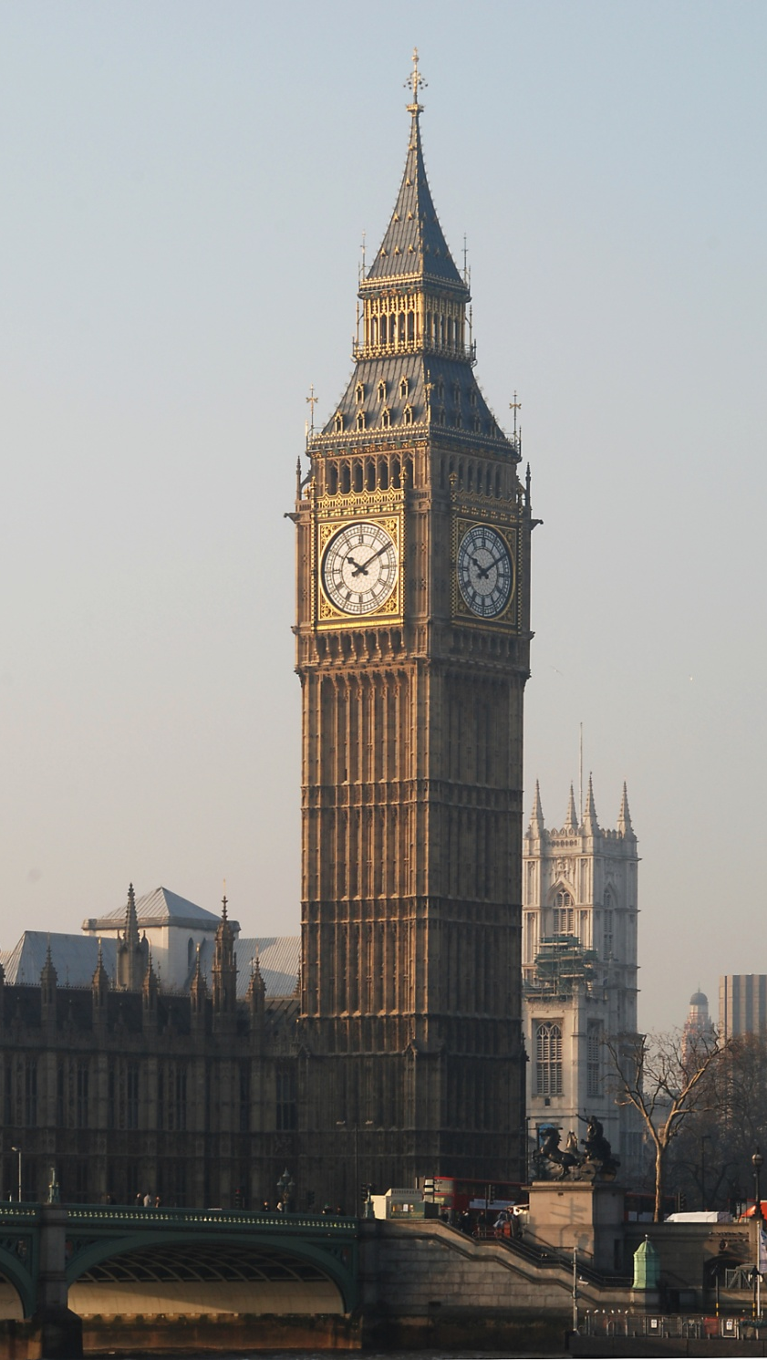
Big Ben Big Ben is a bell in the clock tower in London. There are two versions of the origin of the name of the tower. The first version says that Big Ben was named after Sir Benjamin Hall, who ran the casting of the bell. Another says that the heariest bell at the moment (13.7 tonns) got its name after Benjamin County, a very famous boxer in the heavyweight division at the time. The tower was built on the design of English architect Augustus Pugin in 1858. For the first time the clock was wound on May 21, 1859. Officially, the tower was named as "The Clock Tower of Westminster Palace". When the clock on the tower rush or lag (the error is smal - only 1.5-2 seconds) an old English penny is placed on the pendulum. Putting or a coin the superintendent manages to get the precision of the mashinery. Now Big Ben is one of the most famous constructions of the UK.

Slide 5
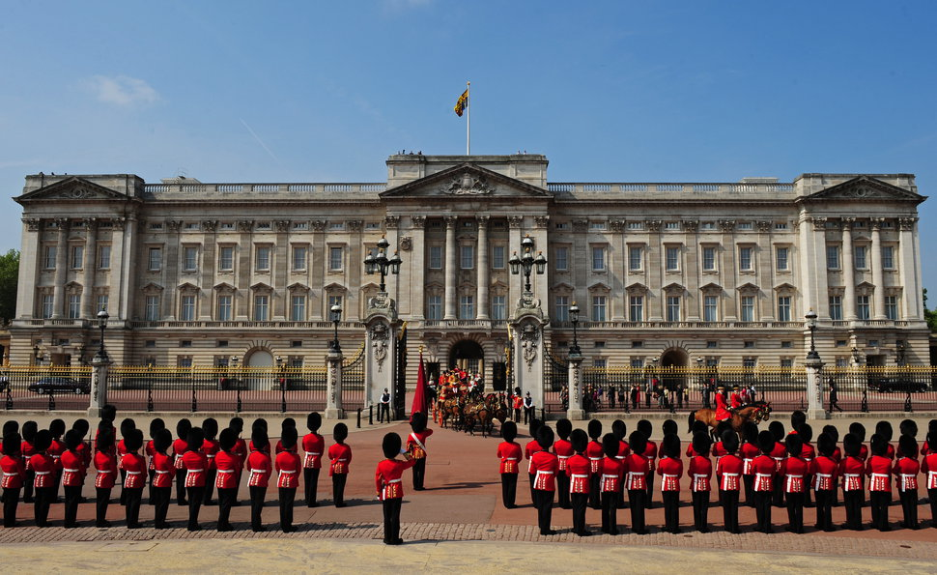
Buckingham Palace With its architecturally defined profile, this is one of London's most popular historical buildings. Buckingham Palace was built in 1703 for the Duke of Buckingham. Later restored by Nash, the present facade was planned by Sir Aston Webb in 1913. At the west end of the Mall, Buckingham Palace is the London residence of the Sovereign. When the Queen is here, the royal standard flut­ters over the palace. The Royal Mews, in Buckingham Palace Road, house the coaches and horses used on all state occasions and are open to the public on Wednesday and Thursday. The Queen's Gallery, also in Buckingham Palace Road; has especial exhibitions from the Royal collection and may be visited every day except Monday. In its entirety, the Palace and the beautiful gardens which surround it occupy an area of approximately 40 acres. Altogether this is one of the most interesting places in London for the tourist.

Slide 6
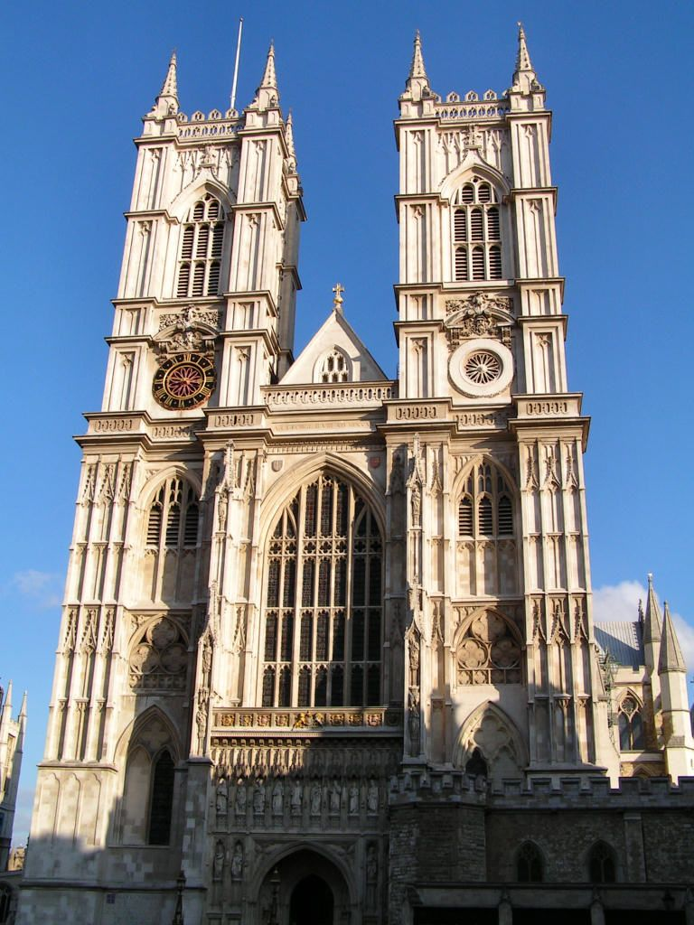
Westminster Abbey Westminster Abbey also known as Collegiate Church of St. Peter is a Gothic church on the scale of a cathedral. Westminster Abbey has been the traditional place of coronation and burial for English monarchs for a long time. Today it is still used for the celebration of great events in the country’s history and for regular worship.

Slide 7
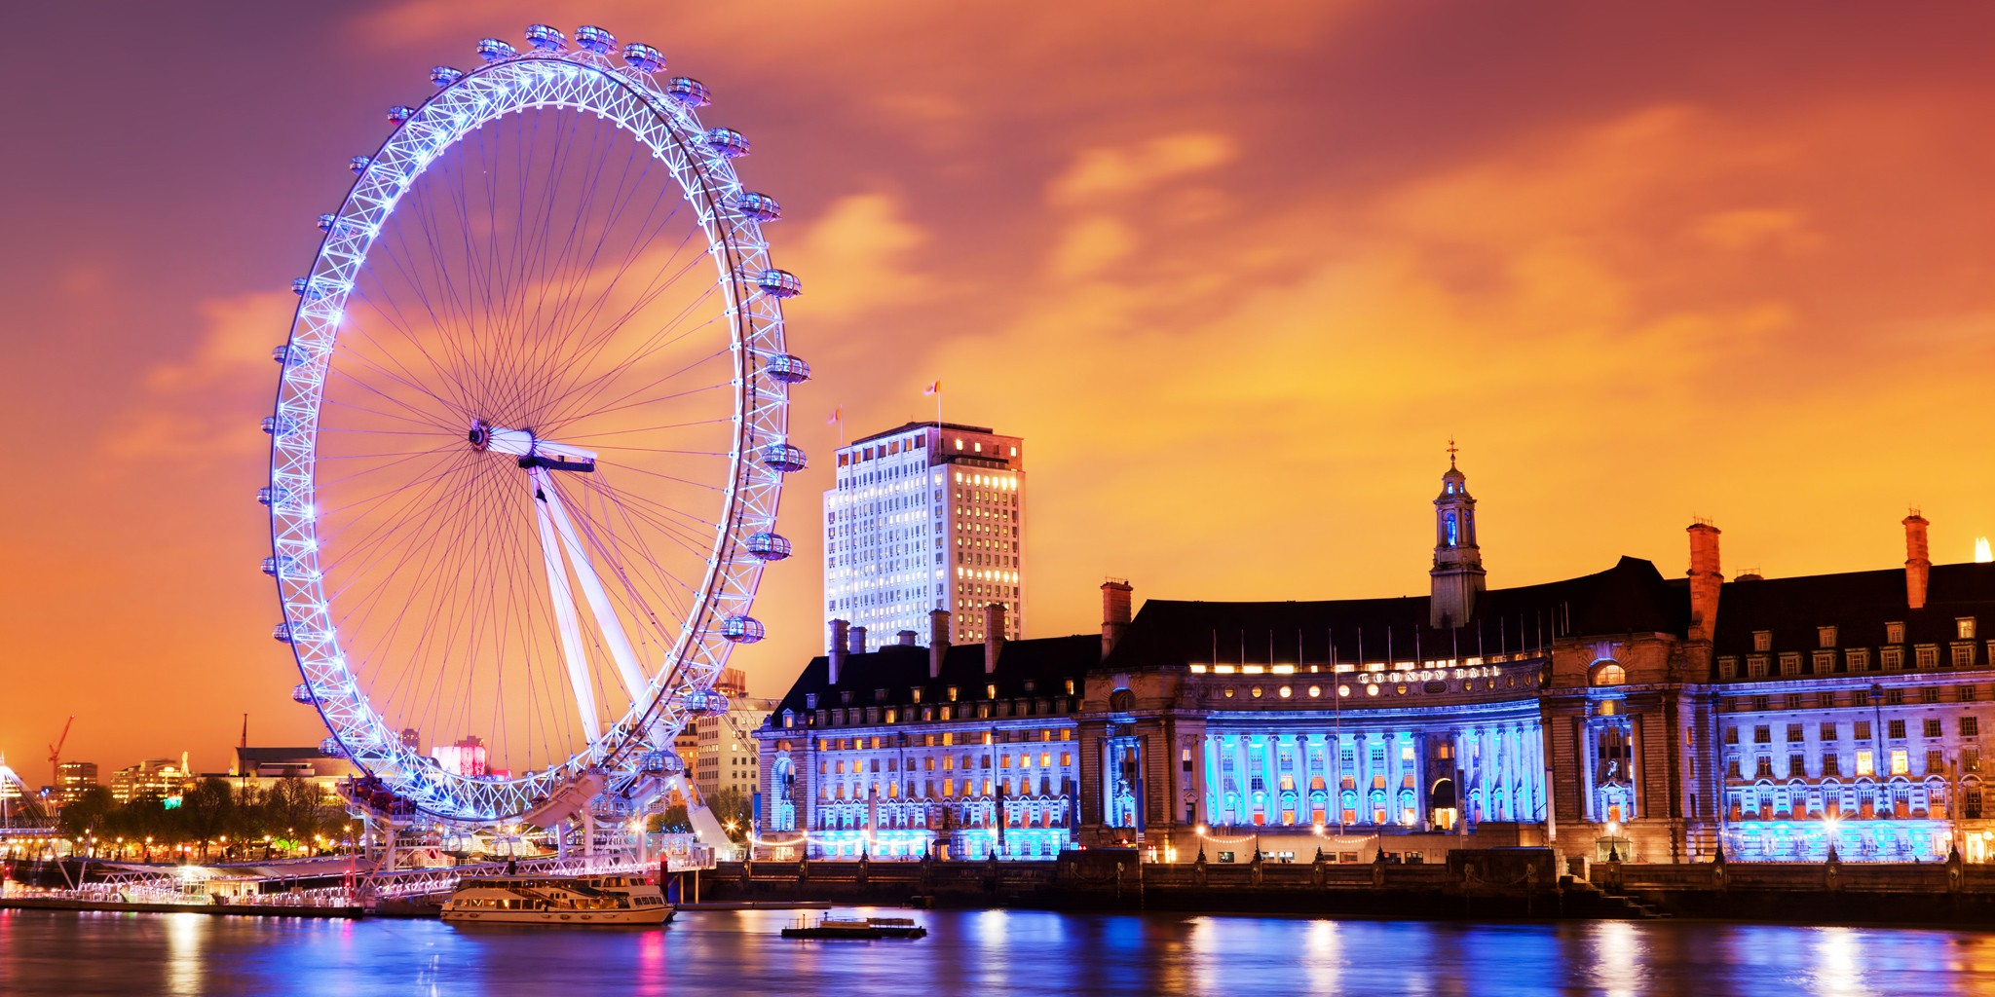
The London Eye The London Eye is the major feature of London’s skyline. It consists of thirty-two capsules each holding up twenty-five people. For breathtaking experience and unforgettable view of more than fifty London’s famous landmarks you have just to climb aboard and take a thirty minute ‘excursion’.

