Slide 1
Scorpions
Scorpions is a German Hard Rock/Heavy Metal Band from Hannover.

Slide 3
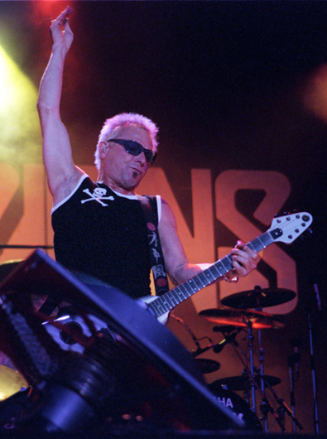
Members of the group
Paul Mantsivoda (bass guitar)
Rudolf Schenker (guitar)

Slide 4
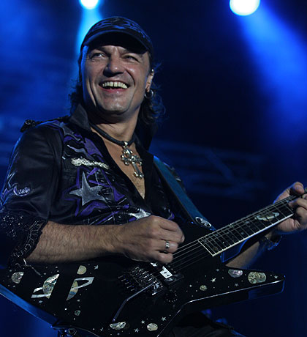
Members of the group
Klaus meine (singing, guitar)
Mathias Jabs(Guitar)

Slide 5
Members of the group
James Kottak (Drums)

Slide 6
History
Group founded in 1965 in the German city Honovere. They performed concerts in different countries. Several trips to the USSR, made concerts in Moscow and Leningrad.
The founders is guitarist Rudolf Schenker and drummer Wolfgang Dziony in the course of the Bit and the rock era as an Amateur group, originally under the name Nameless, then, you could agree on a suitable name.

Slide 7
Studio album
Live album
1972: Lonesome Crow
1974: Fly to the Rainbow
1975: In Trance
1976: Virgin Killer
1977: Taken by Force
1979: Lovedrive
1980: Animal Magnetism
1982: Blackout
1984: Love at First Sting
1988: Savage Amusement
1990: Crazy World
1993: Love in sky
1996: Pure Instinct
1999: Eye II Eye
2004: Unbreakable
2007: Humanity - Hour I
2010: Sting in the Tail
1978: Tokyo Tapes
1985: World Wide Live
1995: Live Bites
2001: Acoustica
2011: Live 2011 – Get Your Sting and Blackout
Other Album
2000: Moment of Glory (mit den Berliner Philharmonikern)
1992: Still Loving You (Remix)
2011: Comeblack

Slide 8
Scorpions in Finnland, 2003

Slide 9
Scorpions live in Bulgarien

Slide 10
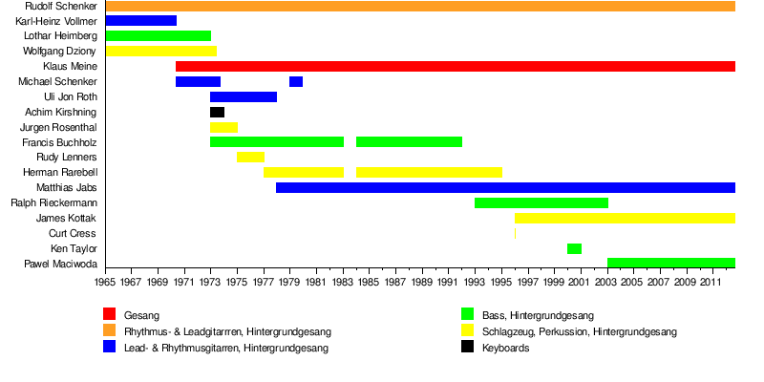
Cast overview, from 1965 to 2013

Slide 11
Videography
1985: First Sting (VHS)
1985: World Wide Live (VHS)
1988: To Russia with Love and Other Savage Amusements (VHS)
1991: Crazy World Tour Live (VHS)
2000: Moment of Glory – Live (DVD)
2001: Acoustica (DVD)
2002: A Savage Crazy World (DVD)
2005: Unbreakable World Tour 2004 – One Night in Vienna (DVD)
2007: Live at Wacken Open Air 2006: A Night to Remember – A Journey Through Time (DVD)
2009: Amazonia – Live in the Jungle (DVD)
2011: Scorpions Live in 3D (Blu-Ray 3D)

Slide 13
The end.

Slide 14
