Slide 1
Yury Gagarin
Ivanova Veronika 7a

Slide 2
Yury Gagarin
On April 12, 1961, Yury Gagarin made history by being the first human to orbit the earth.
As a precaution, engineers at the Soviet Academy of Sciences had an onboard computer, as well as mission control steer the craft, "Vostok 1". They did this because the feared that being in the weightlessness of space, you might be disabled or not be able to move very much. He wouldn't need any food for his single orbit trip, but scientists wanted to know if he could eat in the weightlessness of space.
.

Slide 3
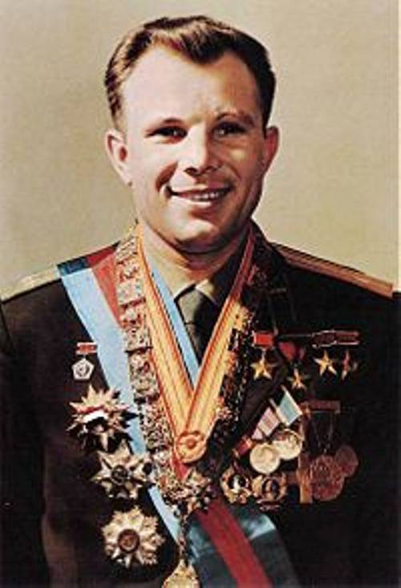
Before Gagarin climbed aboard the rocket, he made a speech. His speech said things such as how beautiful a moment this was, to go into space. He was glad to, "meet nature face to face, in an unprecedented encounter.«
Перед полетом Гагарин произнес речь. В ней говорилось, как прекрасно, что у него есть возможность полететь в космос. Он был рад «встретиться с глазу на глаз с природой» во время полета.

Slide 4
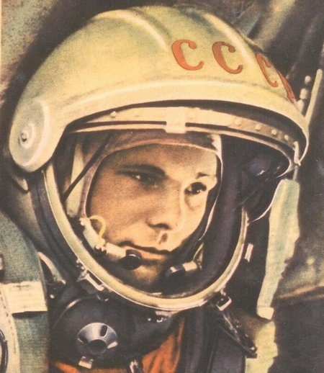
As Gagarin passed through the lower atmosphere, the nose pointed canopy separated, exposing the "Vostok 1" capsule, allowing Gagarin to see the dark blue sky turn into a black space as he was shot into orbit, around the earth.
Когда Гагарин прошел нижний слой атмосферы, отделилась защита носовой части, раскрывая герметическую кабину «Востока 1». Гагарин увидел темное синее небо, которое стало черным космическим пространством, когда корабль вышел на орбиту Земли.

Slide 5
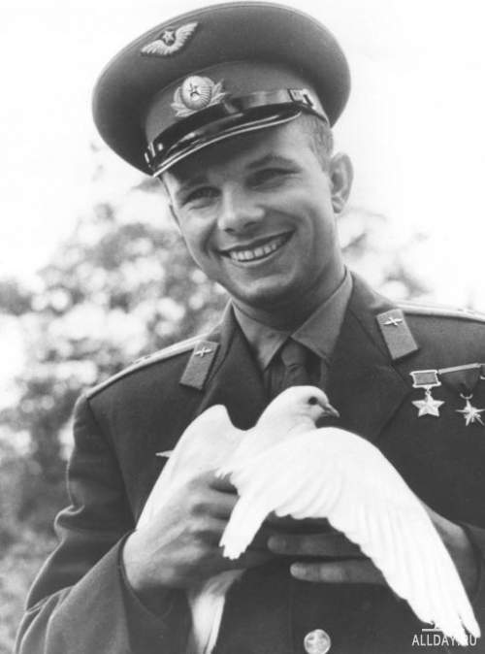
During his life Gagarin was given several ranks and awarded several medals and orders. Many streets, institutions, crafts and aircrafts are named after Yuri Gagarin. The town of Gzhatsk was renamed Gagarin in honour of the first person to travel into space.
In March 1968 Gagarin died in a crash during a routine training flight.
В течение жизни Гагарину было присвоено несколько званий и вручено несколько наград и орденов. Имя Гагарина присвоено многим улицам, учреждениям, судам и самолетам. Город Гжатск впоследствии был переименован в Гагарин в честь первого человека, полетевшего в космос.
В марте 1968 Гагарин погиб, выполняя тренировочный полет.

Slide 6
Thank you for your attention

