Slide 1
I Technologies in the life of modern students
Kommunar
School №1 Form 10

Slide 2
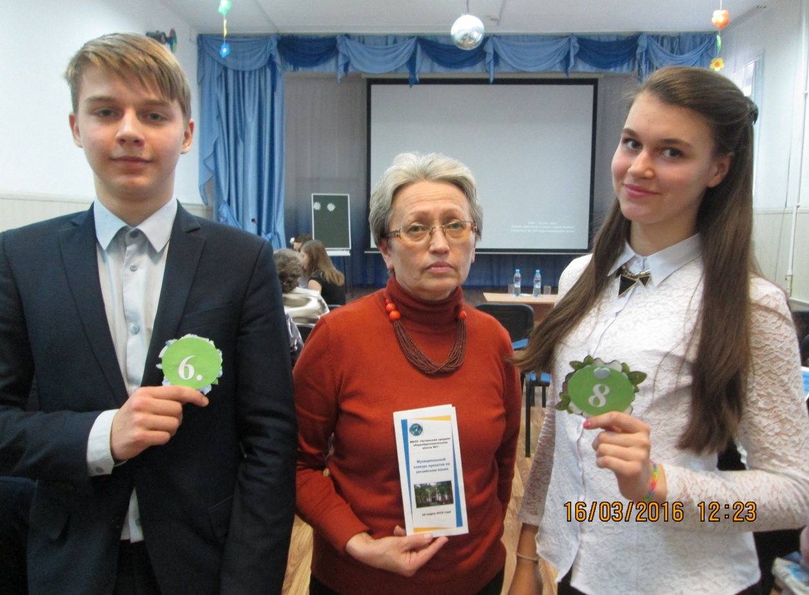
Working group:
Form 10

Slide 3
Plan
1 - Subject
2 - What is ITechnologies, their role in the modern world
3 - Problem to solve
4 - Objectives
5 - Method of solutions problem
6 - Summarizing results
7 - Result

Slide 4
What is ITechnologies?

Slide 5
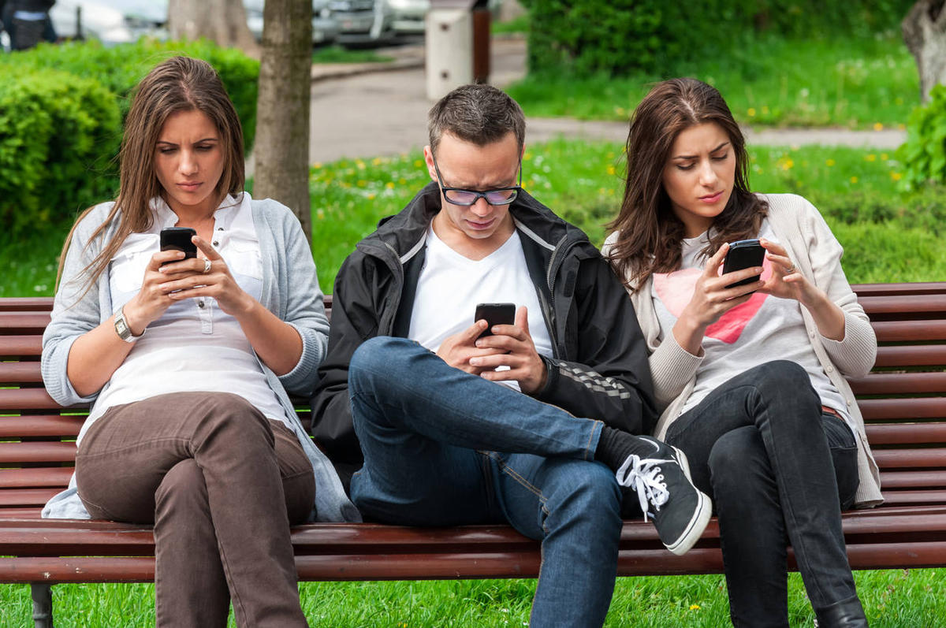
The more people use technology, the less they communicate
Too much information, no time to think.
Technology helps you to keep up-to-date.
Talking with technology is impersonal.
You can always keep in touch with your friends.
Technology lets you use language in new ways.
Emoticons and texting are killing language.

Slide 6
We all use IT. Information technologies has become a part of our life.
IT is a useful kind of communication :
It helps us to contact with different people where and when we want.
We can send our messages through over the world.
IT is a harmful kind of communication:
We don`t see these who are near.
IT calls addictive in people.

Slide 7
THE FIVE DEADLY DANGERS OF THE INTERNET
YOU CAN GET ARRESTED IF YOU DOWNLOAD COPYRIGHTED MATERIAL
YOU DON’T KNOW WHO YOU’RE REALY TALKINGTO ON CHAT SITES
PEOPLE CAN MANIPULATE PHOTOS THAT YOU SEND ON THE INTERNET
SPYWARE PROGRAMMER CAN STEAL YOUR PERSONAL INFORMATION
YOU CAN GET A COMPUTER VIRUS

Slide 8
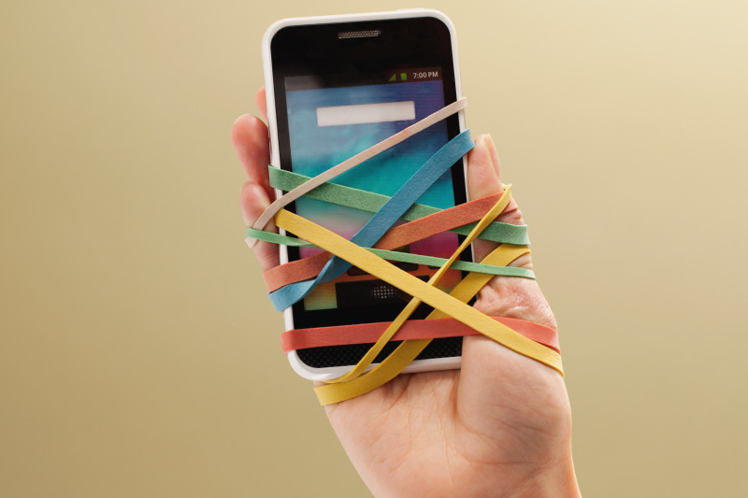
Way out of this problem ? (Dependence on IT)
IT addiction is a problem of the modern society.
How to deal with it ?
You can:
Limit the time to use IT
Talk about this problem
Use IT for self-development
Find a hobby
Do sport
Communicate more in the real world

Slide 9
Whether to adopt electronic textbooks?
Pupils and students all over the world used traditional textbooks during some centuries. But let’s look at this question from IT
+ Electronic books can save ecology. Every day people destroy a lot of forests. Imagine how many trees we can save.
+ Replacement textbooks will help to improve the health of children.
- But this idea has drawbacks. Vision begins to deteriorate. To avoid this you can alternate mathematics and Russian with music lessons and physical education.

