Slide 1
Isaac Newton
Elizaveta Kudasova 7 A

Slide 2
"Isaac Newton - Исаак Ньютон"
Newton, one of the greatest scientists of all times was born in 1642 in the little village in Lincolnshire, England. His father was a farmer and died before Newton was born. His mother was a clever woman whom he always loved

Slide 3
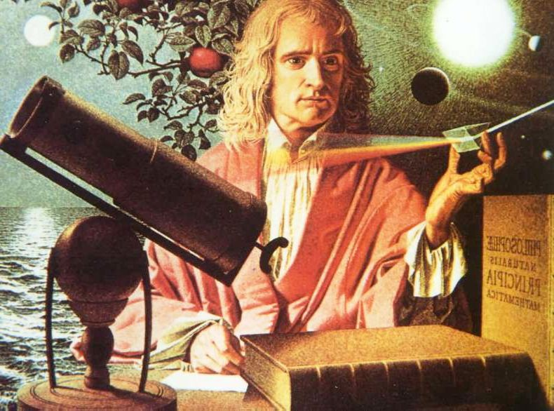
After school, Newton studied mathematics at Cambridge university and received his degree in 1665. Then the university was closed because of the danger of plague and Newton went home for eighteen months. It was most important period in his life when he made his three great discoveries — the discoveries of the differential calculuses, of the nature of white light, and of the law of gravitation.

Slide 4
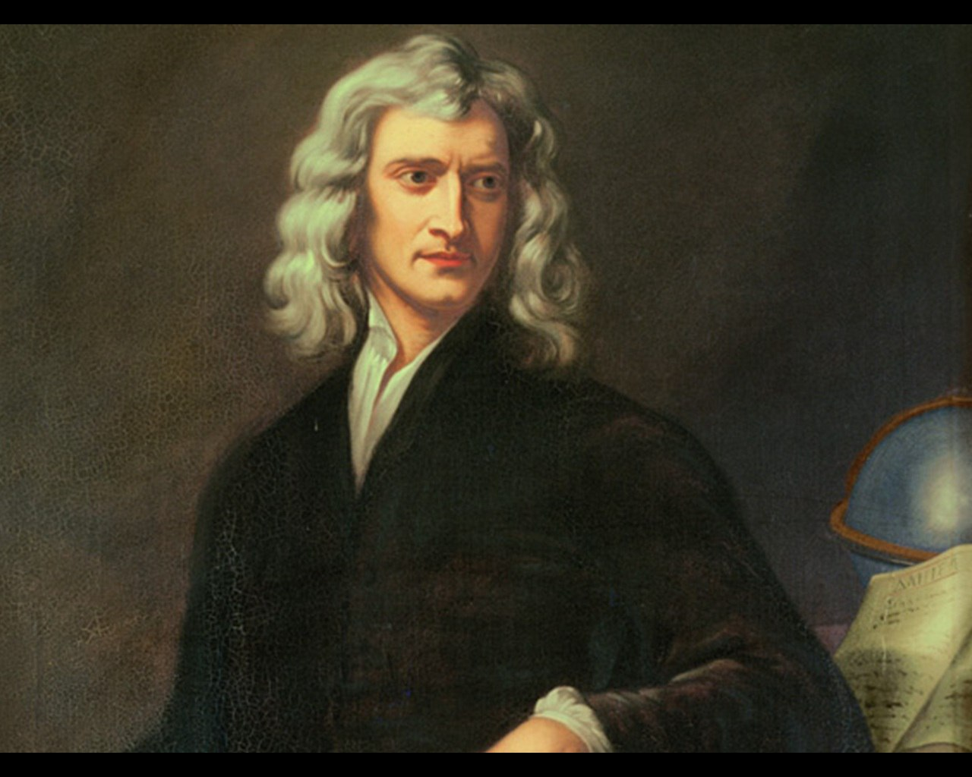
These discoveries are still important for the modern science. Newton had always been interested in the problems of light. Many people saw colours of a rainbow but only Newton showed, by his experiments, that white light consists of these colours.
It is interesting how he discovered the law gravitation. Once, as he sat at the garden, his attention was drawn by the fall of an apple. Many people saw such an usual thing before.

Slide 5
But it was Newton who asked himself a question: "Why does that apple fall perpendicularly to the ground? Why doesn't it go sidewards or upwards?" The answer to this question was the theory of gravitation, discovered by Newton.
Newton died at the age of 84, and was buried in Westminster Abbey, where his monument stands today.

Slide 6
THANK YOU FOR YOUR ATTANTION

